Slide 1
Parameterized Algorithms (and Complexity)
Daniel Lokshtanov?

Slide 2
If L is NP-hard
no algorithm solves
- all instances
- optimally
- in polynomial time.
What about the easy instances?
How to capture the notion of easy instances?

Slide 3
Size matters?
The bit-size of the input instance is
never the only thing that
affects the running time of an algorithm
BFS/DFS: O(n + m)
Subset Sum: O(nt)
k-SAT: O(2^{n(1-1/k)})
k-Clique: O(n^{k+2})

Slide 4
Parameterized Complexity
Measure the running time of algorithms as a function of size and something else.
Mostly applied to NP-hard problems

Slide 5
Example: Vertex Cover
Input:
Graph G, integer k
Question:
Is there a vertex set S, s.t. |S| $≤$ k and every edge has at least one endpoint in S?
O(2^{n}n²)
O(n^{k+2})
Polynomial for every fixed k
f(k)n^{g(k)}
XP
Slicewice Polynomial

Slide 6
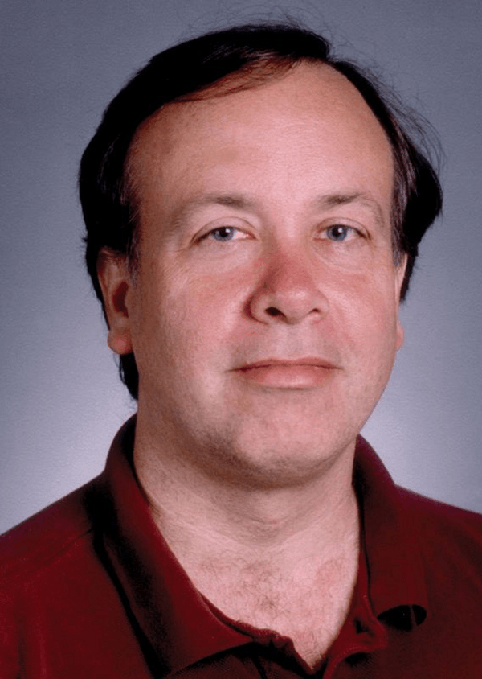
Vertex Cover in O(n + m + k^{O(k)}) time
delete and decrease k by 1
delete
Vertices of degree 0
are irrelevant
S.R.Buss, before 93
Vertices of degree k
must be in solution
If > k² edges → no!
Every vertex has degree at most k
If $≤$ k² edges → $≤$ 2k² vertices,
Brute force is k^{O(k)}!

Slide 7
Even better?
Let uv $∈E\left(G\right).$
At least one of u and v must be in the solution.
G has a vertex cover of size $≤$ k
$$↔$$
G\u has a vertex cover of size $≤$ k-1
G\v has a vertex cover of size $≤$ k-1
OR
Recursive algorithm!

Slide 8
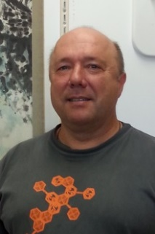
Running time
k
k-1
k-1
k-2
k-2
k-3
k-3
...
Total running time is O(2^{k}n^{c})

Slide 9
Combining the two methods
Pick vertices of
degee $≥$ k+1
Into the solution
G,k
G’,k’
k$′≤$ k
time O(n+m)
|E(G’)| $≤$ 2k²
Apply O(2^{k}n^{c})
time algorithm
Total time: O(n + m + 2^{k}k^{c})

Slide 10
Same problem, three algorithms
XP
Even better than FPT?
n^{k+2}
2^{k}(n+m)
n+m+2^{k}k²
Same polynomial for every fixed k
f(k)n^{c}
FPT
Fixed Parameter Tractable

Slide 11
f(k)n^{c} vs f(k) + n^{c}
f(k) + n^{c}
$$≤$$
f(k)n^{c}
f(k)² + n^{2c}
$$≥$$
f(k)n^{c}

Slide 12
Are all problems XP? FPT?
Coloring
In: Graph G, integer k
Question: Is G properly k-colorable?
NP-complete for k = 3
XP algorithm would be polynomial time for k=3

Slide 13
Picture so far
Graph Coloring
XP
Anyone here?
Vertex
Cover
Yes!
FPT

Slide 14
Independent Set
Input:
Graph G, integer k
Question:
Is there a vertex set S, s.t. |S| $≥$ k and no edge has both endpoints in S?
XP: O(n^{k}k²)
FPT?
Probably no, but how to «prove» this?

Slide 15
P vs NP
$$2^{n^{O(1)}}$$
NP
NP
complete
P

Slide 16
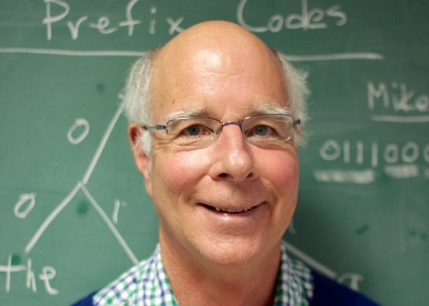
Parameterized Complexity
XP
W[1]
Fellows
W[1]
hard
W[1]
complete
FPT
Ind. Set.
Downey
Vertex Cover
1992
Coloring

Slide 17
Research Flowchart
XP?
FPT?
☺
YES
YES
NO, NP-c for fixed k
NO, W[1]-hard
☹
☹
,

Slide 18
Clique
Input:
Graph G, integer k
Question:
Is there a vertex set S, s.t. |S| $≥$ k and every pair of vertices in S are adjacent?
XP: O(n^{k}k²)
FPT?

Slide 19
Clique is W[1]-hard
FPT algorithm for Clique
(G̅, k)
f(k)n^{c}
FPT algorithm for Independent Set
(G, k)
f(k)n^{c}

Slide 20
Independent Set $≤$ Vertex Cover?
Can we reduce Independent Set to Vertex Cover?
NOT FPT!
O(2^{n-k})
time algorithm
For IS
G has Independent Set of size $≥$ k
$$↔$$
2^{k} + n + m
time algorithm
For VC
G has Vertex Cover of size $≤$ n-k

Slide 21
Clique Parameterized by Max Degree
Input:
Graph G of maximum degree $Δ$, integer k
Question:
Is there a vertex set S, s.t. |S| $≥$ k and every pair of vertices in S are adjacent?
Algorithm:
For every vertex v, look for the largest
clique inside N(v).
Time:
O(2^{Δ}n)
FPT!

Slide 22
Same Problem – Different Parameters
«Clique is W[1] hard»
no f(k)n^{c} time algorithm
Clique parameterized
by solution size k
is W[1] hard.
Many different ways of parameterizing same problem.
No single one is «the right» one.
Clique parameterized
by maximum
degree Δ is FPT.
O(2^{Δ}n) time algorithm

Slide 23
Parameterized Problems
A parameterized (decision) problem
is a subset of $Σ^{∗}× ℕ$
Clique_{/Soln size}
(s,k) : s encodes a graph G and G has a clique of size $≥$ k
Clique_{/Max degree}
(s, $Δ$) : s encodes a graph G and an integer k, and G has max degree $≤Δ$and a clique of size $≥$ k

Slide 24
Research Flowchart
Try new parameter
XP?
FPT?
☺
YES
YES
V.C. / soln.size
Clique / Max Degree
NO, NP-c for fixed k
NO, W[1]-hard
New parameter
☹
☹
Clique / soln. size
,
Coloring / #colors
Ind. Set / soln. size
Try new parameter

Slide 25
k-Coloring parameterized by VC
Input: G, integer k, set X $⊆$ V(G) such that X is a vertex cover of G, integer x = |X|.
Question: Does G have a proper k-coloring?
Parameter: x
FPT now means f(x)n^{O(1)}.

Slide 26
k-Coloring parameterized by VC
If x+1 $≤$ k say YES
X
Thus, assume k $≤$ x.
Branch on k^{x} colorings of X.
I = V(G) \ X
For each guess, color I greedily.
Total running time: O(k^{x} $⋅$(n+m)) = O(x^{x} $⋅$(n+m)).

Slide 27
Above Guarantee Vertex Cover
So far we have only seen the solution size as the parameter for vertex cover.
Alternative parameter $μ=$ solution size – MM(G)
Maximum Matching
Note that $μ$ can be very small even if solution size is big!

Slide 28
Above Guarantee Vertex Cover
In: G, k
Question: Does there exist a vertex cover S of size at most k?
Parameter: $k−MM(G)$ where MM(G) is the size of a maximum matching in G.
Now FPT means f($k−MM(G)$)n^{c} time!
Theorem: O(${2.32}^{k−MM(G)}$n^{c}) time algorithm
for Vertex Cover

Slide 29
Research Flowchart
Try new parameter
XP?
FPT?
☺
YES
YES
V.C. / soln.size
Clique / Max Degree
NO, W[1]-hard
NO, NP-c for fixed k
Coloring / V.C.
New parameter
V.C. / soln.size – MM(G)
☹
☹
Clique / soln. size
,
Coloring / #colors
Ind. Set / soln. size
Try new parameter

Slide 30
Faster Independent Set?
O(n^{k}k²) time algorithm
Have:
Much room for progress!
No f(k)n^{c} unless FPT = W[1]

Slide 31
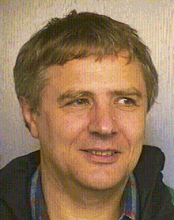
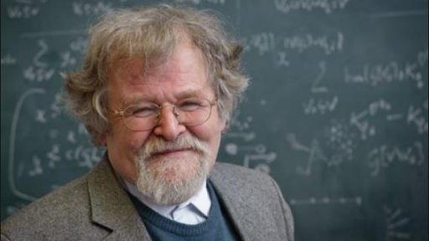
Faster Independent Set!
J. Nesetril, S. Poljak, 1985
Independent Set in time
O($n^{{ωk}/3}$)
= O(n^{0.79k})
Matrix multiplication constant
Hint: Triangle if and only if trace(A³) $≠$ 0

Slide 32
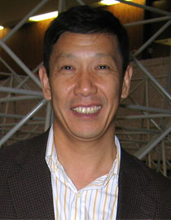
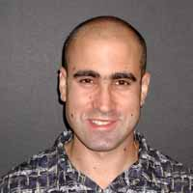
Faster Vertex Cover
O(2^{k}k² + n + m) time algorithm
Next lecture: O(1.47^{k} + n + m)
Have:
Chen, Kanj: O(1.274^{k} + n + m)
No O(n^{c}) unless P = NP

Slide 33
Research Flowchart
Try new parameter
XP?
FPT?
Better FPT?
YES
YES
NO, W[1]-hard
NO, NP-c for fixed k
YES
New parameter
☹
Better XP?
,
YES
Try new parameter

Slide 34
Can we just keep improving?
Can we do Independent Set in time O(n^{0.1k})? O(n^{0.001k})? What about $O(n^{\sqrt{k}})$?
Can we do Vertex Cover in time O(2^{0.1k}n^{c})? O(2^{0.001k}n^{c})? What about $O(2^{\sqrt{k}}n^{c})$?

Slide 35
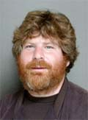
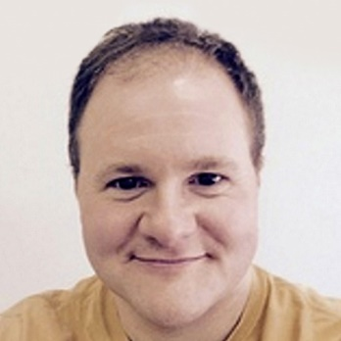
The Exponential Time Hypotnesis
Impagliazzo
Paturi
Zane
ETH: Exists ε > 0 such that 3-SAT has no O(2^{εn}) time algorithm.

Slide 36
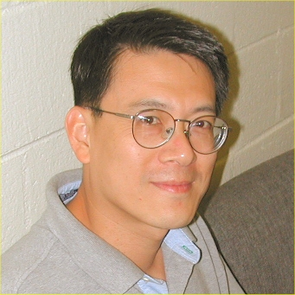
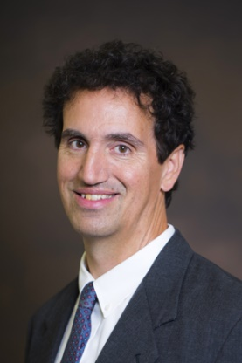
ETH based lower bounds
Cai
Juedes
Assuming the ETH, there exists ε > 0
such that there is no O(2^{εk}n^{c}) time algorithm
for Vertex Cover, …
(Just trace the NP-completeness reduction!)

Slide 37
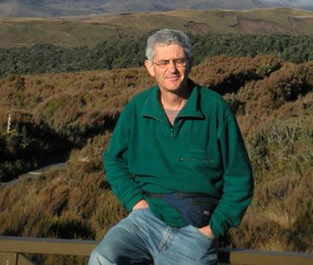
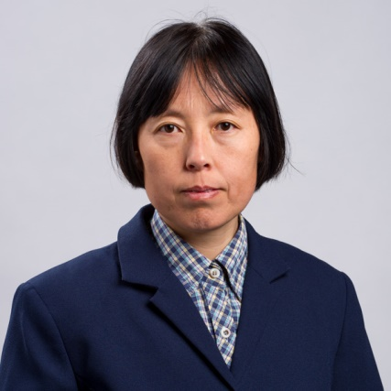
ETH based lower bounds
Fellows
Chen
Chor
Huang
Juedes
Kanj
Xia
Exists ε > 0 s.t. there is
no f(k)n^{εk} time for Independent Set

Slide 38
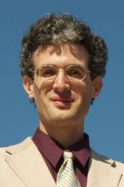
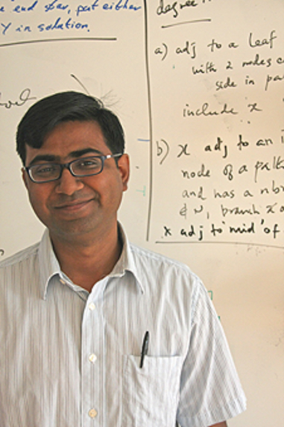
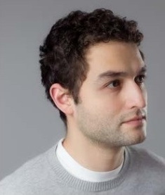
Graph Coloring / Vertex Cover
O(x^{x} + n + m) time algorithm
for Graph Coloring on graphs with
Vertex Cover $≤$ x
Saw:
Marx
Saurabh
L.
Assuming ETH there exists ε > 0 s.t. there is
no O(x^{εx}n^{c}) time for Graph Coloring

Slide 39
Research Flowchart
Try new parameter
XP?
FPT?
Better FPT?
YES
YES
NO, W[1]-hard
NO
NO, NP-c for fixed k
YES
New parameter
☹
YES
ETH Lower Bound?
,
Better XP?
Try new parameter
NO

Slide 40
Limitations of the ETH
(So far) lower bounds under ETH
are all on the form
exists ε > 0 s.t. there is no O(2^{εf(k)}n^{c}) time algorithm…
How to distinguish between 2^{k} and 1.99^{k}?

Slide 41
More to come
Restricting Input
Connections to Approximation Schemes
Kernels
FPT-Approximation
And kernel lower bounds
And inapproximability
Approximate Kernels
And lower bounds
Connections to
polynomial time
Minding the n^{c}

Slide 42
Thank you!

