Slide 1
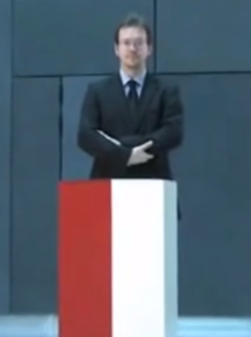
Computational Social Choice (Part I: Overview)
Piotr Faliszewski
AGH University Kraków, Poland
faliszew@agh.edu.pl
Recent Advances in Parametrized Complexity – Tel Aviv 2017

Slide 2
U. Endriss (Ed.), Trends in Computatinal Social Choice, 2017
F. Brandt, V. Conitzer, U. Endriss, J. Lang, A. Procaccia (Eds.), Handbook of Computational Social Choice, 2016
R. Bredereck, J. Chen, P. Faliszewski, J. Guo, R. Niedermeier, G. Woeginger, Parameterized Algorithmics for Computational Social Choice: Nine Research Challenges, Tsinghua Science and Technology, 2014
N. Betzler, R. Bredereck, J. Chen, R. Niedermeier, Studies in computational aspects of voting. A parameterized complexity perspective, The Multivariate Algorithmic Revolution and Beyond, 2012
Computational Social Choice
10/19 ☺
Collective Decision Making
Voting
Cooperative Games
Judgment Aggregation
Matching Under Preferences
Fair Allocation

Slide 3
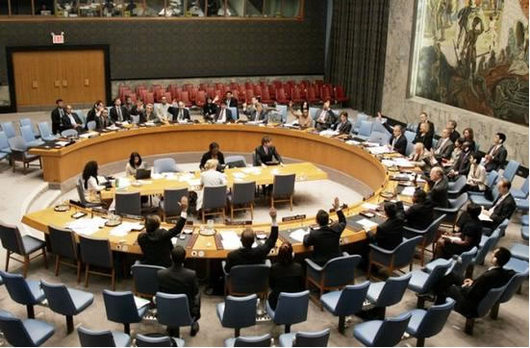
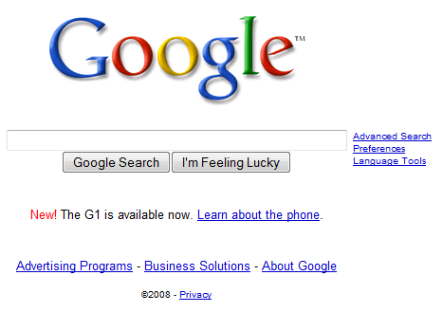
Why Are Elections Important?
Politics
Electing leaders
Deciding policies, laws
…
Business settings
Stock holders make decisions in companies
University Senates, hiring decisions
Competitions (e.g., racing, Eurovision)
Multiagent systems
Meta-search engines
Planning
Recommendation systems
Genetic algorithms
…
Elections aggregate the opinions of the voters

Slide 4
Computational Social Choice
(voting)
election formalism
(single winner)
ordinal
approval-based

Slide 5
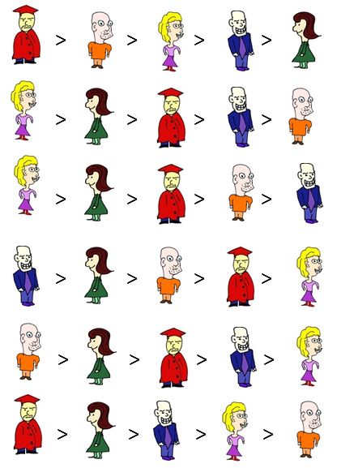
Formal Setting
Elections
E = (C, V)
f – voting rule
f( E ) = W – tied winners
C = { , , , , }
V = (v₁, … , v₆)
V₁:
V₂:
V₃:
V₄:
V₅:
V₆:

Slide 6
Formal Setting
Elections
E = (C, V)
f – voting rule
f( E ) = W – tied winners
Examples of voting rules:
Plurality
C = { , , , , }
V = (v₁, … , v₆)
1 0 0 0 0
V₁:
V₂:
V₃:
V₄:
V₅:
V₆:

Slide 7
Formal Setting
Elections
E = (C, V)
f – voting rule
f( E ) = W – tied winners
Examples of voting rules:
Plurality
Borda
C = { , , , , }
V = (v₁, … , v₆)
4 3 2 1 0
V₁:
V₂:
V₃:
V₄:
V₅:
V₆:

Slide 8
Formal Setting
Elections
E = (C, V)
f – voting rule
f( E ) = W – tied winners
Examples of voting rules:
Plurality
Borda
k-Approval
C = { , , , , }
V = (v₁, … , v₆)
1 1 0 0 0
V₁:
V₂:
V₃:
V₄:
V₅:
V₆:

Slide 9
Formal Setting
Elections
E = (C, V)
f – voting rule
f( E ) = W – tied winners
Examples of voting rules:
Plurality
Borda
k-Approval
Veto
C = { , , , , }
V = (v₁, … , v₆)
1 1 1 1 0
V₁:
V₂:
V₃:
V₄:
V₅:
V₆:

Slide 10
Formal Setting
Elections
E = (C, V)
f – voting rule
f( E ) = W – tied winners
Condorcet winner and majority graph:
C = { , , , , }
V = (v₁, … , v₆)
V₁:
V₂:
V₃:
V₄:
V₅:
V₆:

Slide 11
Formal Setting
Elections
E = (C, V)
f – voting rule
f( E ) = W – tied winners
Copeland Rule
C = { , , , , }
V = (v₁, … , v₆)
V₁:
3
4
V₂:
0.5
V₃:
V₄:
V₅:
V₆:
0.5
1

Slide 12
Formal Setting
Elections
E = (C, V)
f – voting rule
f( E ) = W – tied winners
Examples of voting rules:
Plurality
Borda
k-Approval
Veto
Copeland
Dodgson
Kemeny
C = { , , , , }
V = (v₁, … , v₆)
V₁:
V₂:
V₃:
V₄:
V₅:
V₆:

Slide 13
Formal Setting
Elections
E = (C, V)
f – voting rule
f( E ) = W – tied winners
Examples of voting rules:
Plurality
Borda
k-Approval
Veto
Copeland
Dodgson
Kemeny
STV
…
C = { , , , , }
V = (v₁, … , v₆)
V₁:
V₂:
STV: Eliminate whoever has lowest plurality score, until someone has majority support
V₃:
V₄:
V₅:
V₆:

Slide 14
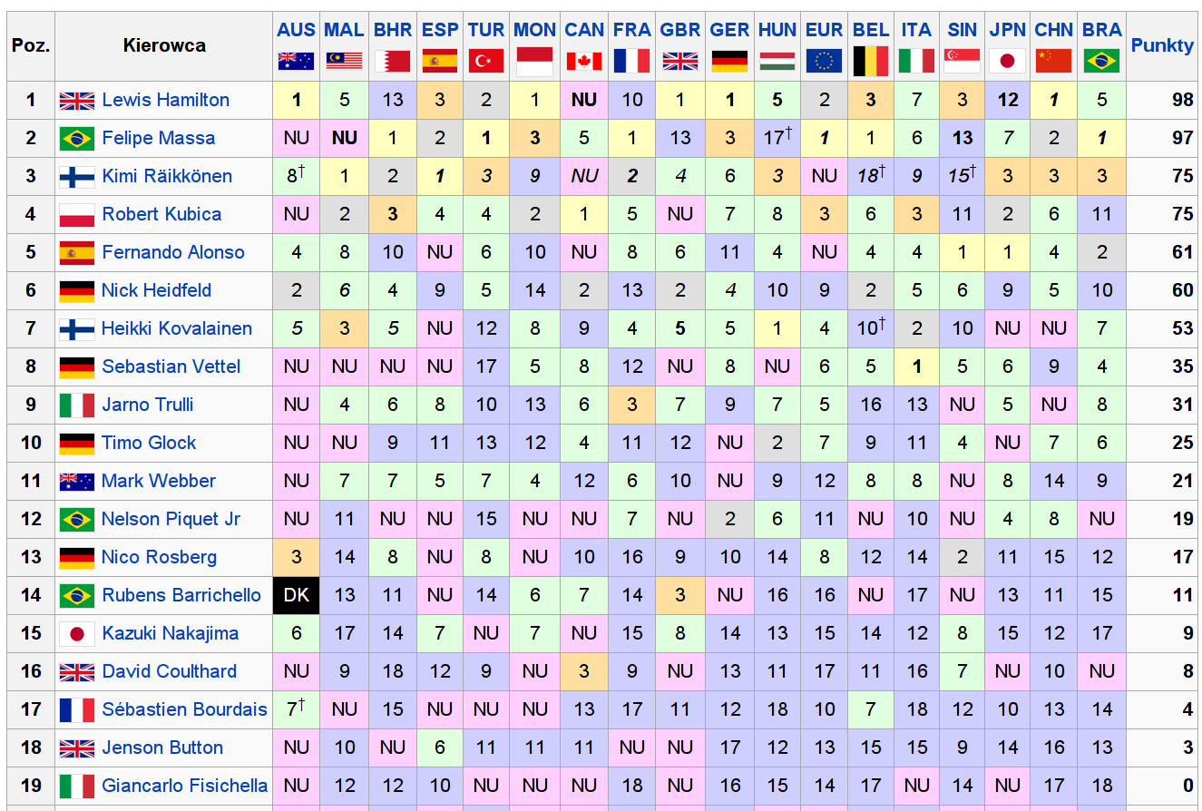
Formula 1: Season 2008
Drivers receive points: 10, 8, 6, 5, 4, 3, 2, 1

Slide 15
Formula 1: Other Voting Rules
 | Official | Borda | Plurality | 2-appr | 3-appr | 4-appr | Copeland | Maximin | STV
Lewis Hamilton | 1 | 1 | 2 | 2 | 1 | 1 | 2 | 1 | 2
Felipe Massa | 2 | 3 | 1 | 1 | 1 | 1 | 1 | 9 | 1
Kimi Räikkonen | 3 | 5 | 3 | 3 | 3 | 1 | 3 | 1 | 3
Robert Kubica | 4 | 2 | 5 | 3 | 4 | 4 | 4 | 1 | 5
Fernando Alonso | 5 | 6 | 3 | 6 | 6 | 5 | 7 | 5 | 3
Nick Heidfeld | 6 | 4 | 8 | 3 | 5 | 6 | 5 | 1
Heikki Kovalainen | 7 | 7 | 5 | 7 | 6 | 7 | 6 | 5 | 5
Sebastian Vettel | 8 | 12 | 5 | 8 | 9 | 9 | 12 | 17 | 5
Jarno Trulli | 9 | 8 | 8 | 12 | 9 | 9 | 8 | 5
Timo Glock | 10 | 10 | 8 | 8 | 9 | 8 | 9 | 5

Slide 16
Formula 1: Other Voting Rules
 | Oficjalny | Borda | Plurality | 2-appr | 3-appr | 4-appr | Copeland | Maximin | STV
Lewis Hamilton | 1 | 1 | 2 | 2 | 1 | 1 | 2 | 1 | 2
Felipe Massa | 2 | 3 | 1 | 1 | 1 | 1 | 1 | 9 | 1
Kimi Räikkonen | 3 | 5 | 3 | 3 | 3 | 1 | 3 | 1 | 3
Robert Kubica | 4 | 2 | 5 | 3 | 4 | 4 | 4 | 1 | 5
Fernando Alonso | 5 | 6 | 3 | 6 | 6 | 5 | 7 | 5 | 3
Nick Heidfeld | 6 | 4 | 8 | 3 | 5 | 6 | 5 | 1
Heikki Kovalainen | 7 | 7 | 5 | 7 | 6 | 7 | 6 | 5 | 5
Sebastian Vettel | 8 | 12 | 5 | 8 | 9 | 9 | 12 | 17 | 5
Jarno Trulli | 9 | 8 | 8 | 12 | 9 | 9 | 8 | 5
Timo Glock | 10 | 10 | 8 | 8 | 9 | 8 | 9 | 5
Arrow’s Theorem (intuition)
There is no perfect, always fair, voting rule
Conclusions
Voting rules are designed and used for specific purposes (but they will always have flaws)

Slide 17
Computational Social Choice
(voting)
Plurality
Borda
committee elections
t-Approval
scoring rules
Bucklin
other ideas (iterative etc.)
election formalism
(single winner)
STV
ordinal
Copeland
approval-based
Maximin
Condorcet rules (graphs!)
Dodgson

Slide 18
winner determination
problem families
Computational Social Choice
(voting)
Plurality
Borda
t-Approval
scoring rules
Bucklin
other ideas (iterative etc.)
election formalism
(single winner)
STV
ordinal
Copeland
approval-based
Maximin
Condorcet rules (graphs!)
Dodgson

Slide 19
winner determination
problem families
Computational Social Choice
(voting)
Plurality
Borda
t-Approval
scoring rules
Bucklin
other ideas (iterative etc.)
election formalism
(single winner)
STV
ordinal
Copeland
approval-based
Maximin
Condorcet rules (graphs!)
Dodgson

Slide 20
Dodgson Score
V₁:
Dodgson Score of candidate c: Smallest numer of swaps of adjacent candidates that ensures that cancidate c is a Condorcet winner
V₂:
V₃:
V₄:
V₅:
V₆:
Dodgson score of is 0 (she is a Dodgson winner)
Dodgson score of ?

Slide 21
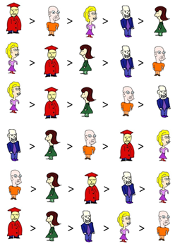
Dodgson Score
V₁:
Dodgson Score of candidate c: Smallest numer of swaps of adjacent candidates that ensures that cancidate c is a Condorcet winner
V₂:
V₃:
V₄:
V₅:
V₆:
J. Bartholdi, C. Tovey, M. Trick, Voting Schemes for which It Can Be Difficult
to Tell Who Won the Election, Social Choice and Welfare, 1989
L. Hemaspaandra, E. Hemaspaandra, J. Rothe, Exact Analysis of Dodgson Elections: Lewis Carroll's 1876 Voting System is Complete for Parallel Access to NP., J. ACM, 1997
N. Betzler, J. Guo, R. Niedermeier, Parameterized computational complexity of Dodgson and Young elections, Information and Computation, 2010
M. Fellows, B. Jansen, D. Lokshtanov, F. Rosamond, S. Saurabh, Determining the Winner of a Dodgson Election is Hard, FSTTCS 2010
I.Caragiannis, J. Covey, M.Feldman, C. Homan, C. Kaklamanis, N. Karanikolas, A. Procaccia, J. Rosenschein, On the approximability of Dodgson and Young elections, Artificial Intelligence, 2012
[….]
Dodgson score of is 0 (she is a Dodgson winner)
Dodgson score of is 2

Slide 22
Dodgson Score is NP-Complete
Reduction from X3C
Election
C = {1,2, …, 3k, 1’, 2’, … 3k’, S₁, …, S_{n}, p}
X3C votes:
1 > 3 > 4 > S₁ > p > …
1 > 3 > 6 > S₂ > p > …
2 > 4 > 5 > S₃ > p > …
…
3
1
Equalizing votes:
1 > 1’ > p > …
1 > 1’ > p > …
4 > 4’ > p > …
…
4
6
2
5
ensure that every set element is preferred to p in the same numer of votes

Slide 23
Dodgson Score is NP-Complete
Reduction from X3C
Election
C = {1,2, …, 3k, 1’, 2’, … 3k’, S₁, …, S_{n}, p}
X3C votes:
1 > 3 > 4 > S₁ > p > …
1 > 3 > 6 > S₂ > p > …
2 > 4 > 5 > S₃ > p > …
…
3
1
Equalizing votes:
1 > 1’ > p > …
1 > 1’ > p > …
4 > 4’ > p > …
…
4
6
2
5
Defeating votes:
1 > 2 > … > 3k > 1’ > 2’ > … > 3k’ > p > …
1 > 2 > … > 3k > 1’ > 2’ > … > 3k’ > p > …
1 > 2 > … > 3k > 1’ > 2’ > … > 3k’ > p > …
…
enough to ensure that for each set element i we have
N_{E}(i,p) – N_{E}(p,i) = 1

Slide 24
Dodgson Score is NP-Complete
Reduction from X3C
Election
C = {1,2, …, 3k, 1’, 2’, … 3k’, S₁, …, S_{n}, p}
X3C votes:
1 > 3 > 4 > S₁ > p > …
1 > 3 > 6 > S₂ > p > …
2 > 4 > 5 > S₃ > p > …
…
3
1
Equalizing votes:
1 > 1’ > p > …
1 > 1’ > p > …
4 > 4’ > p > …
…
4
6
2
5
Defeating votes:
1 > 2 > … > 3k > 1’ > 2’ > … > 3k’ > p > …
1 > 2 > … > 3k > 1’ > 2’ > … > 3k’ > p > …
1 > 2 > … > 3k > 1’ > 2’ > … > 3k’ > p > …
…
p defeats everyone except for the set elements
p has Dodgson score 4k if and only if there is an exact cover

Slide 25
winner determination
possible and necessary winners
winner prediction
margin of victory
problem families
campaign management
bribery
control
changing the result
strategic voting (manipulation)
Computational Social Choice
(voting)
Plurality
Borda
t-Approval
scoring rules
Bucklin
other ideas (iterative etc.)
election formalism
(single winner)
STV
ordinal
Copeland
approval-based
Maximin
Condorcet rules (graphs!)
Dodgson

Slide 26
winner determination
possible and necessary winners
winner prediction
margin of victory
problem families
campaign management
bribery
control
changing the result
strategic voting (manipulation)
Computational Social Choice
(voting)
Plurality
Borda
t-Approval
scoring rules
Bucklin
other ideas (iterative etc.)
election formalism
(single winner)
STV
ordinal
Copeland
approval-based
Maximin
Condorcet rules (graphs!)
Dodgson

Slide 27
Constructive Control by Adding Candidates
Plurality-CCAC
Given:
E = (C, V) – an election
A – additional candidates
p in C – preferred candidate k – budget Question:
Is it possible to ensure p’s victory by adding at most k candidates

Slide 28
Constructive Control by Adding Candidates
Plurality-CCAC
Given:
E = (C, V) – an election
A – additional candidates
p in C – preferred candidate k – budget Question:
Is it possible to ensure p’s victory by adding at most k candidates
> > > >
> > > >
> > > >
> > > >
> > > >
p =
k = 2

Slide 29
Control by Adding Candidates ∈ NP-com
Proof: Reduction from the X3C problem
Exact Cover by 3-Sets
Control by Adding Candidates
Input: B = {b₁, b₂, b₃, … , b_{3k}} S = {S₁, …, S_{n}}
B = { }
S₁={ }
S₂={ }
S₃={ }
S₄={ }
S₅={ }
s(p) = T+1
s( ) = s( )= s( ) = T+1
s( ) = s( )= s( ) = T+1
S₁: > > …
> > …
> > …
S₃: > > …
> > …
> > …
S₅: > >
> >
> >
S₂: > > …
> > …
> > …
S₄: > > …
> > …
> > …
Question: Is it possible to pick k sets and cover all elements from B?

Slide 30
Control by Adding Candidates ∈ NP-com
Proof: Reduction from the X3C problem
Exact Cover by 3-Sets
Control by Adding Candidates
Input: B = {b₁, b₂, b₃, … , b_{3k}} S = {S₁, …, S_{n}}
B = { }
S₁={ }
S₂={ }
S₃={ }
S₄={ }
S₅={ }
s(p) = T+1
s( ) = s( )= s( ) = T+1
s( ) = s( )= s( ) = T+1
S₁: > > …
> > …
> > …
S₃: > > …
> > …
> > …
S₅: > >
> >
> >
S₂: > > …
> > …
> > …
S₄: > > …
> > …
> > …
Question: Is it possible to pick k sets and cover all elements from B?

Slide 31
winner determination
possible and necessary winners
winner prediction
margin of victory
problem families
campaign management
Approximation!
bribery
control
changing the result
strategic voting (manipulation)
Computational Social Choice
(voting)
Plurality
Borda
t-Approval
scoring rules
Bucklin
other ideas (iterative etc.)
election formalism
(single winner)
STV
ordinal
Copeland
approval-based
Maximin
Condorcet rules (graphs!)
Dodgson

Slide 32
winner determination
possible and necessary winners
#voters
election size
winner prediction
#candidates
margin of victory
budget / cost
problem families
campaign management
special features
bribery
parameters
control
changing the result
strategic voting (manipulation)
Computational Social Choice
(voting)
Plurality
Borda
t-Approval
scoring rules
Bucklin
other ideas (iterative etc.)
election formalism
(single winner)
STV
ordinal
Copeland
approval-based
Maximin
Condorcet rules (graphs!)
Dodgson

Slide 33
Dodgson Score:FPT(m)
V₁:
Dodgson Score of candidate c: Smallest numer of swaps of adjacent candidates that ensures that cancidate c is a Condorcet winner
V₂:
V₃:
V₄:
Parameter : Number of Candidates (m)
Answer : ILP
V₅:
V₆:

Slide 34
Dodgson Score:FPT(m)
V₁:
Dodgson Score of candidate c: Smallest numer of swaps of adjacent candidates that ensures that cancidate c is a Condorcet winner
V₂:
V₃:
V₄:
Parameter : Number of Candidates (m)
Answer : ILP
V₅:
$p1, p2, … , pm!$– all possible preference orders
$ni$ – how many voters with preference $pi$ are there?
$xij$– how many votes do we move from $pi$ to $pj$?
$[d > c]i$ – constant set to 1 if $pi$ prefers d to c (0 otherwise)
$swaps(pi,pj)$ – number of swaps to transform $pi$ into $pj$
V₆:

Slide 35
Dodgson Score:FPT(m)
V₁:
Dodgson Score of candidate c: Smallest numer of swaps of adjacent candidates that ensures that cancidate c is a Condorcet winner
V₂:
Parameter : Number of Candidates (m)
Answer : ILP
V₃:
V₄:
$p1, p2, … , pm!$– all possible preference orders
$ni$ – how many voters with preference $pi$ are there?
$xij$– how many votes do we move from $pi$ to $pj$?
$[d > c]i$ – constant set to 1 if $pi$ prefers d to c (0 otherwise)
$swaps(pi,pj)$ – number of swaps to transform $pi$ into $pj$
V₅:
V₆:
Form ILP: $min⁡D$
For each $i,j$: $x_{ij} ≥0$ ← cannot cheat ☺
For each $i$: $\sum_{j}{x_{ij}=n_{i}}$ ← make a legal transformation
For each cand. $d$: $\sum_{j}{\left(\sum_{i}{x_{ij}}\left[d>c\right]j\right)≤}$ $\sum_{j}{\left(\sum_{i}{x_{ij}}\left[c>d\right]j\right)}$ ← c wins with everyone
$\sum_{j}{\sum_{i}{x_{ij} swaps\left(pi,pj \right)≤D}}$ ← ensure Dodgson score $D$
Solve the ILP in FPT time using Lenstra!

Slide 36
winner determination
possible and necessary winners
#voters
election size
winner prediction
#candidates
margin of victory
budget / cost
problem families
campaign management
special features
bribery
parameters
control
changing the result
strategic voting (manipulation)
Computational Social Choice
(voting)
Plurality
Borda
t-Approval
scoring rules
Bucklin
other ideas (iterative etc.)
election formalism
(single winner)
STV
ordinal
Copeland
approval-based
Maximin
Condorcet rules (graphs!)
Dodgson

Slide 37
Plurality-CCAC: W[1]-hard for #voters
Plurality-CCAC
Given:
E = (C, V) – an election
A – additional candidates
p in C – preferred candidate k – budget Question:
Is it possible to ensure p’s victory by adding at most k candidates
> > > >
> > > >
> > > >
> > > >
> > > >
W[1]-hardness via a somewhat tricky reduction from the Clique problem
J. Chen, P. Faliszewski, R. Niedermeier, N. Talmon , Elections with Few Voters: Candidate Control Can Be Easy, Journal of Artificial Intelligence Research, 2017 (AAAI-2015)
C. Maushagen, J. Rothe, Complexity of Control by Partitioning Veto and Maximin Elections and of Control by Adding Candidates to Plurality Elections, ECAI 2016

Slide 38
Plurality-DCAC: FPT for #voters
Plurality-DCAC
Given:
E = (C, V) – an election
A – additional candidates
d in C – despised candidate k – budget Question:
Is it possible to ensure d’s defeat by adding at most k candidates
> > > >
> > > >
> > > >
> > > >
> > > >

Slide 39
Plurality-DCAC: FPT for #voters
Algorithm
Example
Despised :
Guess a defeator:
(add if needed)
> > > >
> > > >
> > > >
> > > >

Slide 40
Plurality-DCAC: FPT for #voters
Algorithm
Example
Despised :
Guess a defeator:
(add if needed)
Voters where either or is first
(or some other registered candidate is ahead)
(cannot do much about them)
Ensure that the defeator has more points than despised
Voters to focus on:
n voters → each candidate has one of 4^{n} signatures
> > > >
> > > >
> > > >
> > > >

Slide 41
Plurality-DCAC: FPT for #voters
Algorithm
Example
Despised :
Guess a defeator:
(add if needed)
Voters where either or is first
(or some other registered candidate is first)
(cannot do anything about them)
Ensure that the defeator has more points than despised
Voters to focus on:
> > > >
> > > >
> > > >
> > > >
n voters → each candidate has one of 4^{n} signatures
A
B
suffices to keep one candidate for each signature
C
D

Slide 42
Plurality-DCAC: FPT for #voters
Algorithm
Example
Despised :
Guess a defeator:
(add if needed)
Voters where either or is first
(or some other registered candidate is first)
(cannot do anything about them)
Ensure that the defeator has more points than despised
Voters to focus on:
> > > >
> > > >
> > > >
> > > >
n voters → each candidate has one of 2^{n} signatures
A
B
suffices to keep one candidate for each signature
Kernel!
B
suffices to keep at most n registered candidates
(the top-ranked registered candidate for each vote)
B

Slide 43
winner determination
possible and necessary winners
#voters
election size
winner prediction
#candidates
margin of victory
budget / cost
problem families
campaign management
special features
bribery
parameters
control
Restricted domains
changing the result
strategic voting (manipulation)
Computational Social Choice
(voting)
Plurality
Borda
t-Approval
scoring rules
Bucklin
other ideas (iterative etc.)
election formalism
(single winner)
STV
ordinal
Copeland
approval-based
Maximin
Condorcet rules (graphs!)
Dodgson

Slide 44
Dodgson in Single-Peaked Elections
> > > >
> > > >
> > > >
> > > >
> > > >
> > > >
> > > >
left
right
Theorem
If election E = (C,V) is single-peaked and the numer of voters is odd, then the top-ranked candidate of the median voter is a Condorcet winner
median voter
Theorem
Computing Dodgson winners under single-peaked elections is in P

Slide 45
Dodgson in Single-Peaked Elections
> > > >
> > > >
> > > >
> > > >
> > > >
> > > >
> > > >
left
right
Idea: Parameterize by distance from being single-peaked?
D. Cornaz, L. Galand, O. Spanjaard, Kemeny Elections with Bounded Single-Peaked or Single-Crossing Width, IJCAI-2013 D. Cornaz, L. Galand, O. Spanjaard, Bounded Single-Peaked Width and Proportional Representation, ECAI-2012
P. Faliszewski, E. Hemaspaandra, L. Hemaspaandra, The complexity of manipulative attacks in nearly single-peaked electorates. Artificial Intelligence, 2014
G. Erdélyi, M. Lackner, A. Pfandler: Computational Aspects of Nearly Single-Peaked Electorates, JAIR 2017

Slide 46
Single-Peaked Width
> > > > > > > >…
> > > > > > > >…
> > > > > > > >…
> > > > > > > >…
> > > > > > > >…
> > > > > > > >…
> > > > > > > >…
left
right

Slide 47
Single-Peaked Width
> > > > > > > >…
> > > > > > > >…
> > > > > > > >…
> > > > > > > >…
> > > > > > > >…
> > > > > > > >…
> > > > > > > >…
left
right
Problem!
Very fragile to perturbations in single votes. Still – an attempt at treewidth-like notion.

Slide 48
Summary: Computational Social Choice
An application domain for parametrized complexity
Approximation for COMSOC is nice, but does not solve all the problems
Sometimes FPT algorithms are the only way
A lot of classification results, but
Few kernelization results
Few attempts at optimizing FPT algorithms
Still maaaany results are missing!
Motivation matters
It’s not enough to get a nice FPT algorithm …
… it has to address some real issue

Slide 49
Thank you!

