Slide 1
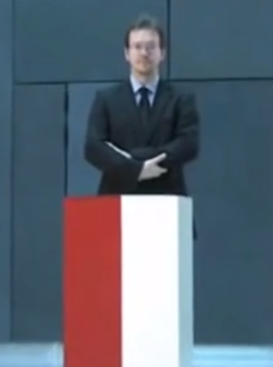
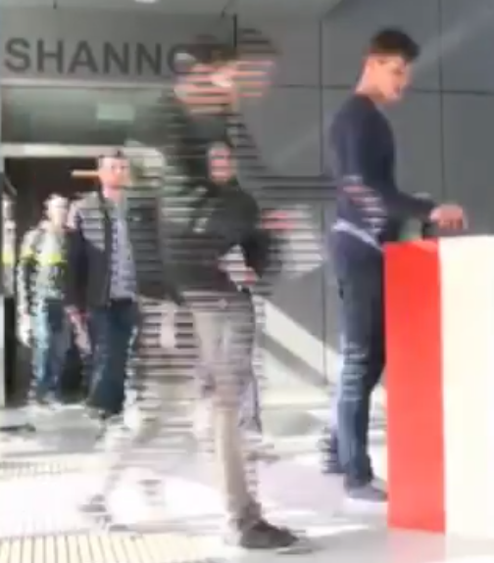
Computational Social Choice (Part III: Committee Elections)
Piotr Faliszewski
AGH University Kraków, Poland
faliszew@agh.edu.pl
Recent Advances in Parametrized Complexity – Tel Aviv 2017

Slide 2
Multiwinner Elections
Single-Winner Elections
movies on a plane
voters’ preferences
voting rule
fundamentally
different!
making a shortlist
Seek the best, the most widely supported candidates
parliaments
P. Faliszewski, P. Skowron, A. Slinko, N.Talmon, Multiwinner Voting: A New Challenge for Social Choice Theory, Trends in Computational Social Choice 2017

Slide 3
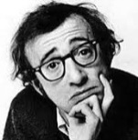
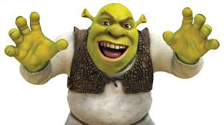
Which movies to put on a plane?
P. Skowron, P. Faliszewski, J. Lang, Finding a collective set of items: From proportional multirepresentation to group recommendation. Artificial Intelligence, 2016
We have the following profile of utilities:
10 8 0 5
I can only put 2 movies on the entertainment system… which ones to pick?
Really? Just 2? What sort of planes did we buy?!?
0 0 12 3
7 3 4 3
2 3 8 9

Slide 4
Which movies to put on a plane?
We have the following profile of utilities:
How to pick two items?
Total utility?
→ 19
→ 14
→ 24
→ 20
10 8 0 5
0 0 12 3
7 3 4 3
2 3 8 9

Slide 5
Which movies to put on a plane?
We have the following profile of utilities:
How to pick two items?
A good movie for everyone?
→ 10+7
→ 8 + 3
→ 12+8
→ 9 + 3
10 8 0 5
0 0 12 3
7 3 4 3
2 3 8 9

Slide 6
Which movies to put on a plane?
We have the following profile of utilities:
How to pick two items?
A customer watches a movie with probability p and chooses to stop watching with probability 1-p.
0 movies : (1-p) 1 movie : p(1-p) 2 movies : p²(1-p)
We should optimize the expected utility!
10 8 0 5
0 0 12 3
7 3 4 3
2 3 8 9

Slide 7
How to capture all these settings?
OWA operators – generalized averages
Sequence of numbers:
u = ( u₁, u₂, u₃, …, u_{k} )
sort
u’ = (u’₁, u’₂, u’₃, …, u’_{k})
( 3, 1, 7, 5, 2)
( 7, 5, 3, 2, 1)
OWA operator
α = (α₁, α₂, …, α_{k})
α₁u’₁ + α₂u’₂ + α₃u’₃ + … + α_{k}u’_{k}

Slide 8
How to capture all these settings?
OWA operators – generalized averages
Sequence of numbers:
u = ( u₁, u₂, u₃, …, u_{k} )
sort
u’ = (u’₁, u’₂, u’₃, …, u’_{k})
( 3, 1, 7, 5, 2)
( 7, 5, 3, 2, 1)
OWA operator
α = (α₁, α₂, …, α_{k})
Artihmetic
average
( 1/5, 1/5, 1/5, 1/5, 1/5)
α₁u’₁ + α₂u’₂ + α₃u’₃ + … + α_{k}u’_{k}
= 3.6

Slide 9
How to capture all these settings?
OWA operators – generalized averages
Sequence of numbers:
u = ( u₁, u₂, u₃, …, u_{k} )
sort
u’ = (u’₁, u’₂, u’₃, …, u’_{k})
( 3, 1, 7, 5, 2)
( 7, 5, 3, 2, 1)
OWA operator
α = (α₁, α₂, …, α_{k})
Maximum
( 1, 0, 0, 0, 0)
α₁u’₁ + α₂u’₂ + α₃u’₃ + … + α_{k}u’_{k}
= 7

Slide 10
How to capture all these settings?
OWA operators – generalized averages
Sequence of numbers:
u = ( u₁, u₂, u₃, …, u_{k} )
sort
u’ = (u’₁, u’₂, u’₃, …, u’_{k})
( 3, 1, 7, 5, 2)
( 7, 5, 3, 2, 1)
OWA operator
α = (α₁, α₂, …, α_{k})
Minimum
( 0, 0, 0, 0, 1)
α₁u’₁ + α₂u’₂ + α₃u’₃ + … + α_{k}u’_{k}
= 1

Slide 11
How to capture all these settings?
OWA operators – generalized averages
Sequence of numbers:
u = ( u₁, u₂, u₃, …, u_{k} )
sort
u’ = (u’₁, u’₂, u’₃, …, u’_{k})
( 3, 1, 7, 5, 2)
( 7, 5, 3, 2, 1)
OWA operator
α = (α₁, α₂, …, α_{k})
Median
( 0, 0, 1, 0, 0)
α₁u’₁ + α₂u’₂ + α₃u’₃ + … + α_{k}u’_{k}
= 3

Slide 12
How to capture all these settings?
OWA operators – generalized averages
Sequence of numbers:
u = ( u₁, u₂, u₃, …, u_{k} )
sort
u’ = (u’₁, u’₂, u’₃, …, u’_{k})
( 3, 1, 7, 5, 2)
( 7, 5, 3, 2, 1)
OWA operator
α = (α₁, α₂, …, α_{k})
Our probability p of watching a movie example, p = 0.1
( 1, p, p², p³, p⁴)
α₁u’₁ + α₂u’₂ + α₃u’₃ + … + α_{k}u’_{k}
= 7.5321

Slide 13
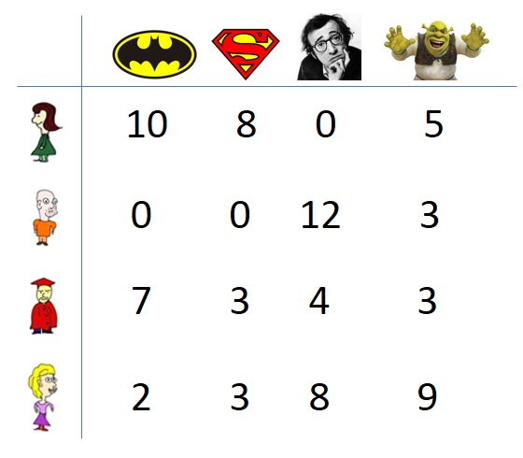
OWA Winner Problem
Definition
N = set of agents
A = set of items
k = total number of items we can pick
α = OWA operator (size k)
For each agent i we have a utility function:
u_{i}: A → N
What is the complexity of the problem? Good approximation algorithms? FPT algorithms?
Let C be a set of k items
u_{i}(C) = α({u_{i}(a) | a in C})
Goal
Find a set C of k items that maximizes u(C) = Σu_{i}(C)

Slide 14
Special utility functions
Approval utilities
Borda utilities
Essentially the hardest case.
Most problems are NP-hard and hard to approximate (in an appropriate sense)
0 0 1 1
1 1 0 1
1 0 1 0
0 0 0 1
The „easiest” case
Still NP-hard, but very good approximations possilbe (PTASes in many cases)
└─e.g., for OWAs with a fixed number of nonzero entries
0 1 2 3
2 3 0 1
2 1 3 0
1 0 2 3

Slide 15
Special utility functions
Approval utilities
Borda utilities
Special OWA families
1-Best OWA (1, 0, … , 0)
t-Best OWA (1, … , 1, 0, …, 0)
k-Best OWA (1, 1, …, 1)
(k-1)-Best OWA (1, …, 1, 0)
t-Median OWA (0, … 0, 1, 0, … 0)
k-Median OWA (0, …, 0, 1)
Hurwicz OWA (x, 0, …, 0, 1-x)
geometric OWA (p⁰, p¹, p², …, p^{k-1})
nonincreasing OWAs
t
0 0 1 1
1 1 0 1
1 0 1 0
0 0 0 1
t-1
(minimum)
0 1 2 3
2 3 0 1
2 1 3 0
1 0 2 3

Slide 16
Special OWA families
1-Best OWA (1, 0, …, 0)
t-Best OWA (1, … , 1, 0, …, 0)
k-Best OWA (1, 1, …, 1)
(k-1)-Best OWA (1, …, 1, 0)
t-Median OWA (0, … 0, 1, 0, … 0)
k-Median OWA (0, …, 0, 1)
Hurwicz OWA (x, 0, …, 0, 1-x)
geometric OWA (p⁰, p¹, p², …, p^{k-1})
nonincreasing OWAs
P-time algorithm
t
NP-complete (even for Borda)
PTAS for Borda ← t/k-approximation
↓
(k-1)/k-approximation (PTAS)
t-1
Almost no hope for good approximation
(minimum)
PTAS for Borda
(1-1/e)-approximation through submodular functions

Slide 17
Special OWA families
1-Best OWA (1, 0, …, 0)
t-Best OWA (1, … , 1, 0, …, 0)
k-Best OWA (1, 1, …, 1)
(k-1)-Best OWA (1, …, 1, 0)
t-Median OWA (0, … 0, 1, 0, … 0)
k-Median OWA (0, …, 0, 1)
Hurwicz OWA (x, 0, …, 0, 1-x)
geometric OWA (p⁰, p¹, p², …, p^{k-1})
nonincreasing OWAs
P-time algorithm
t
NP-complete (even for Borda)
PTAS for Borda ← t/k-approximation
↓
(k-1)/k-approximation (PTAS)
t-1
Almost no hope for good approximation
(minimum)
PTAS for Borda
(1-1/e)-approximation through submodular functions

Slide 18
k-Best: Polynomial Time Algorithm
We simply sum up the scores of all the items and pick the k ones with highest scores
0 1 2 3
2 3 0 1
2 1 3 0
Models several well known multiwinner voting rules:
k-Borda
Bloc
SNTV
1 0 2 3
5
5
7
7

Slide 19
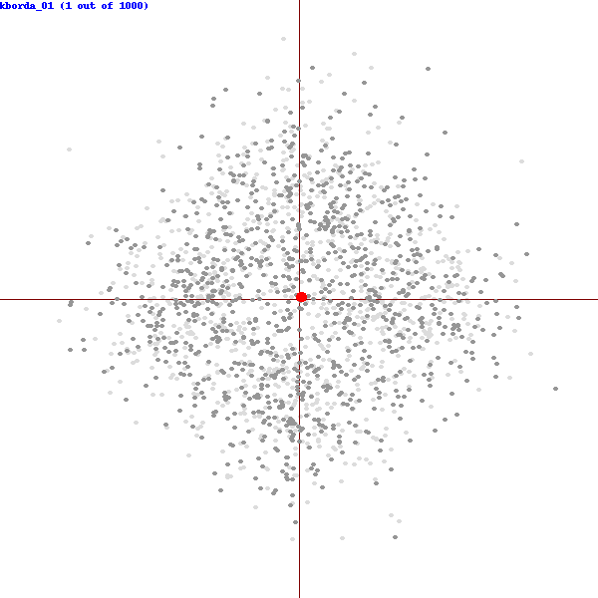
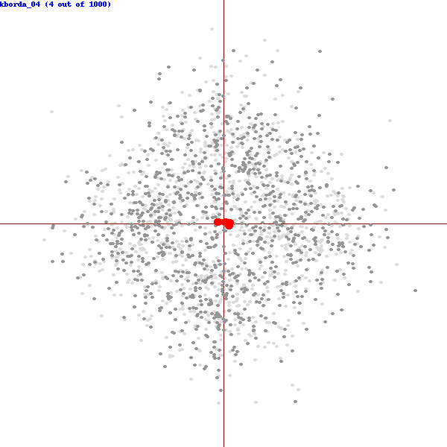
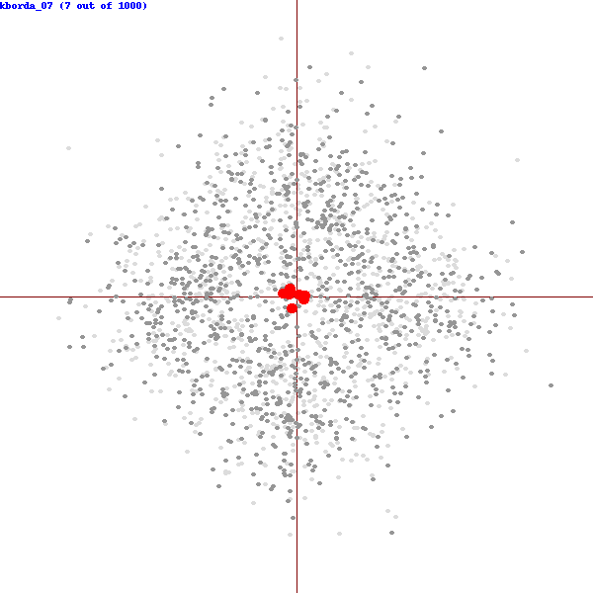
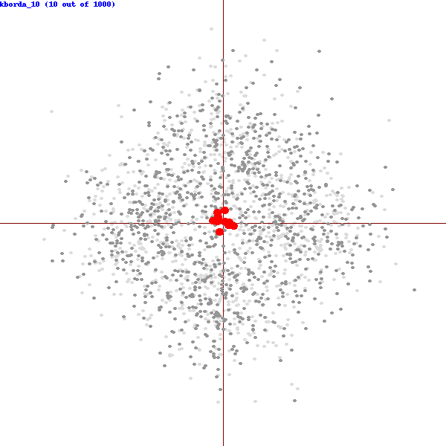
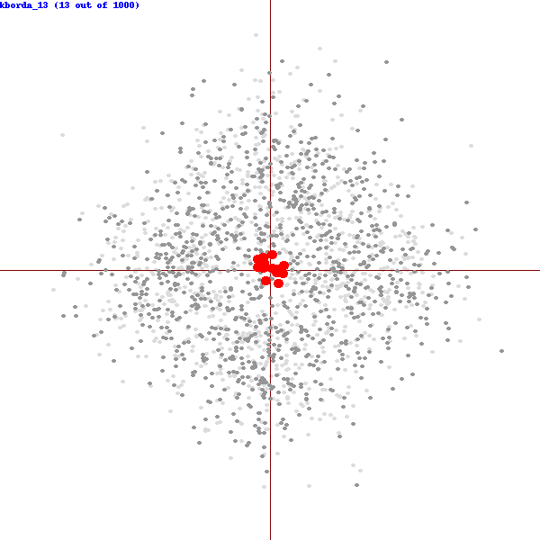
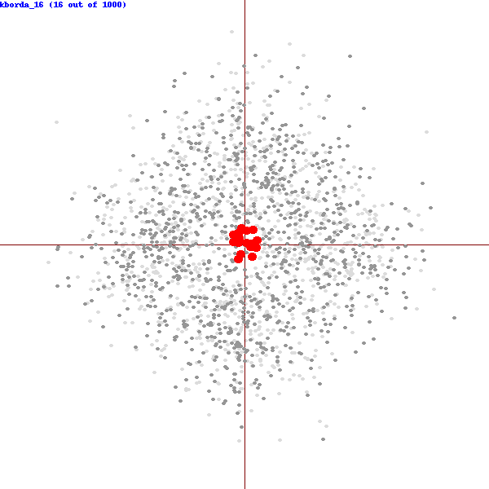
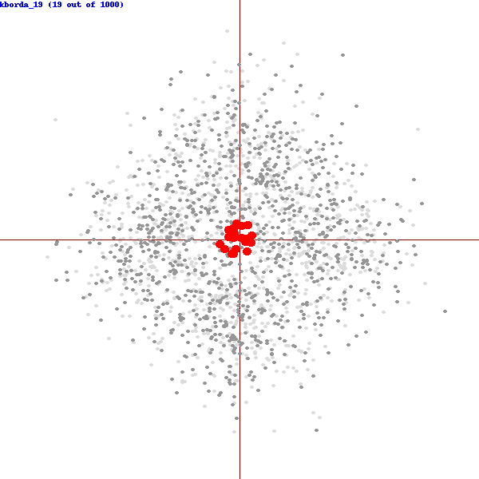
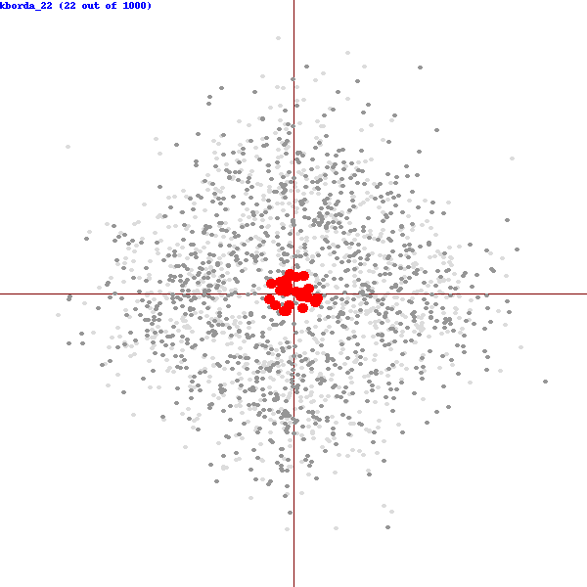
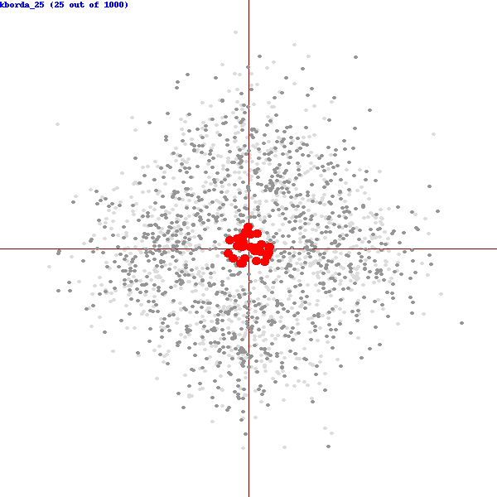
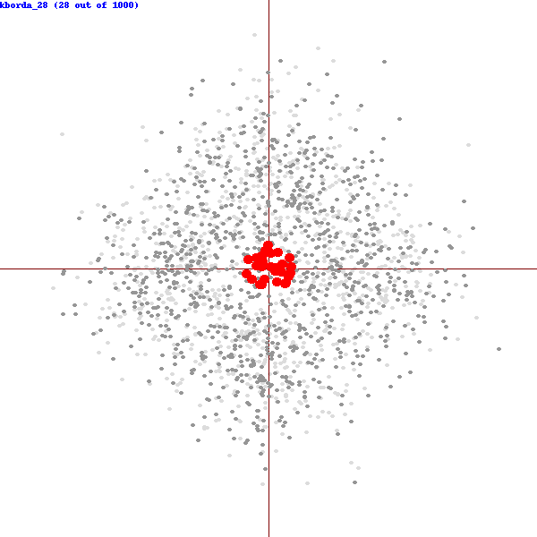
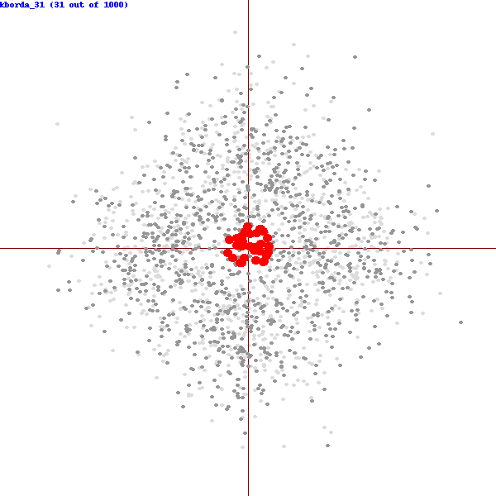
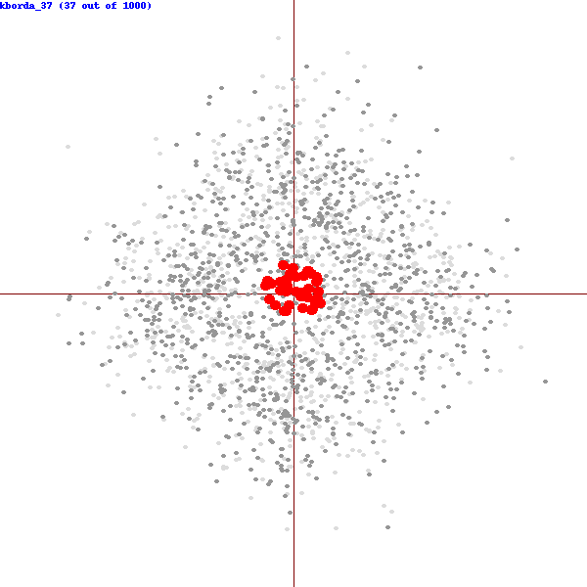
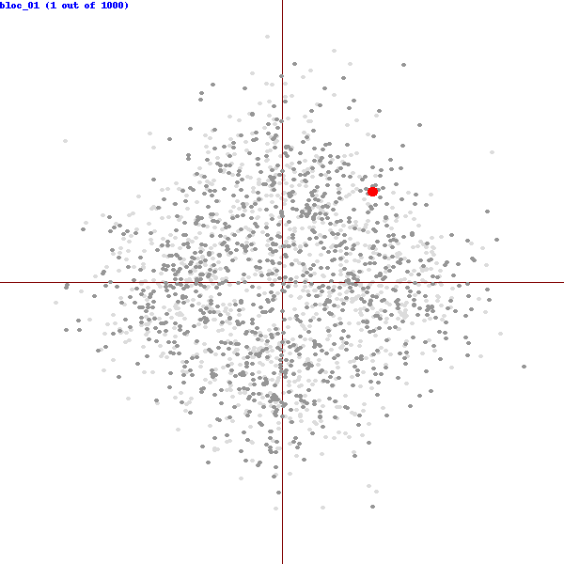
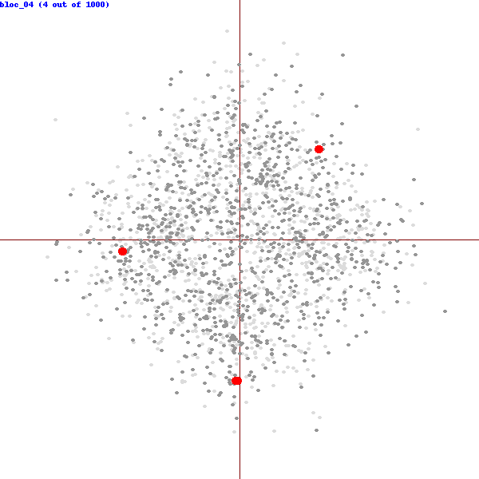
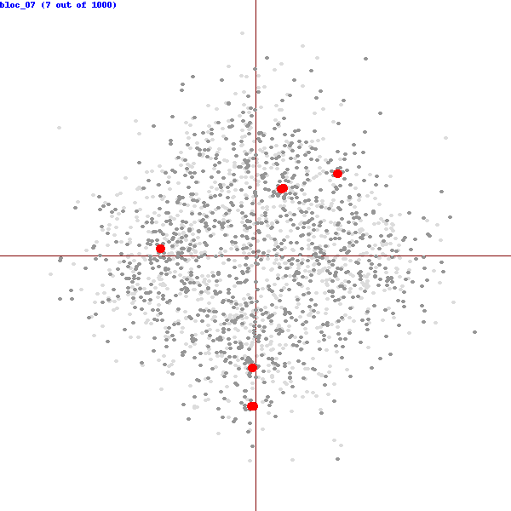
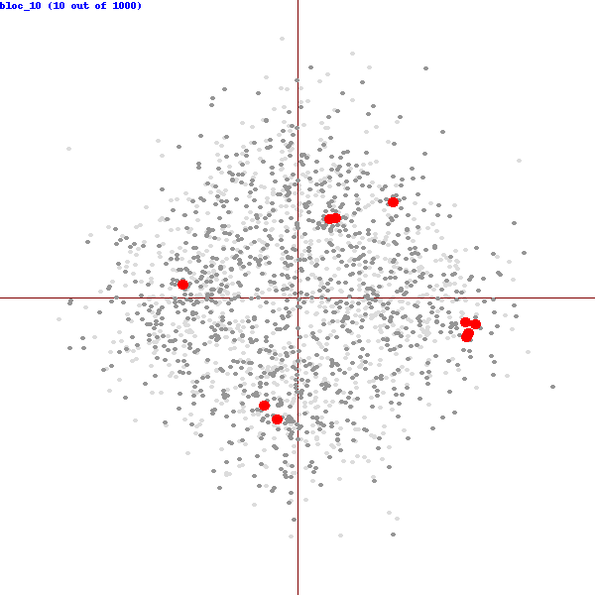
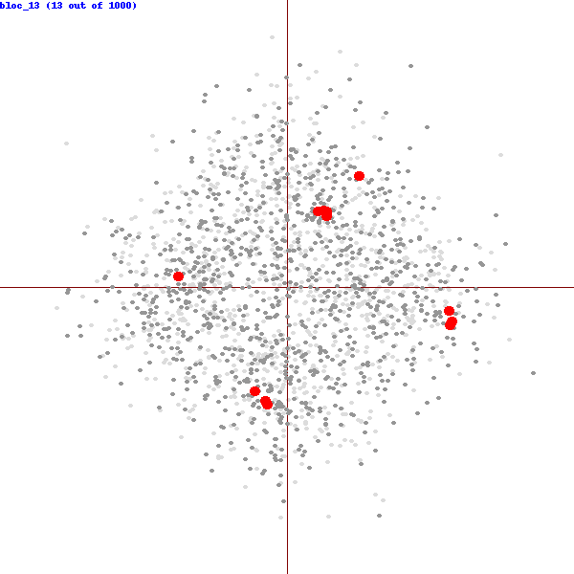
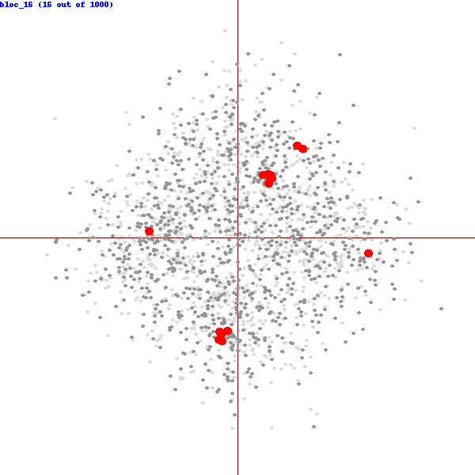
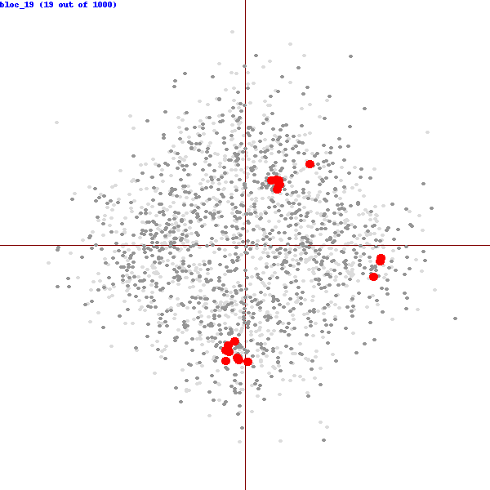
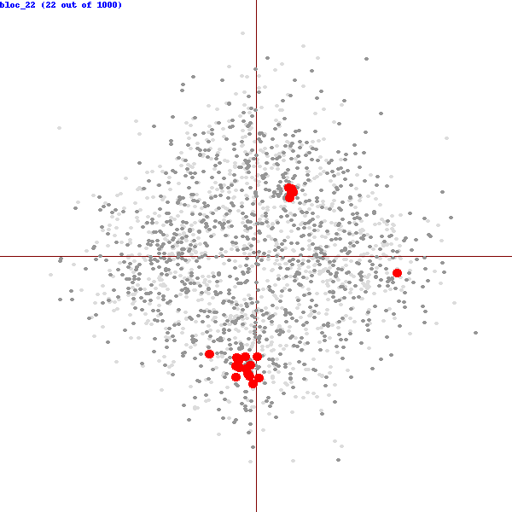
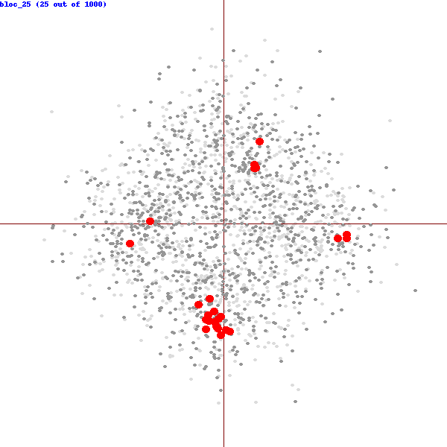
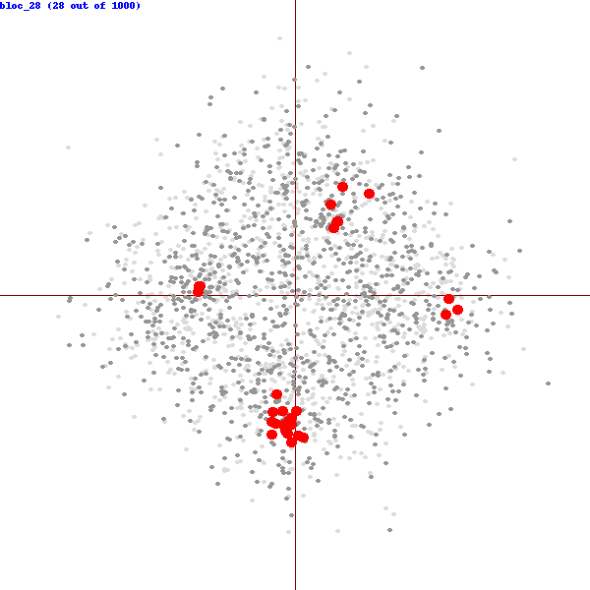
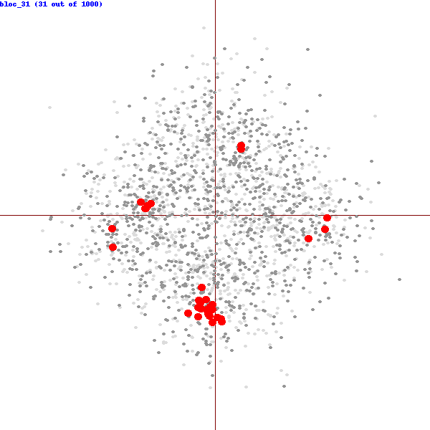
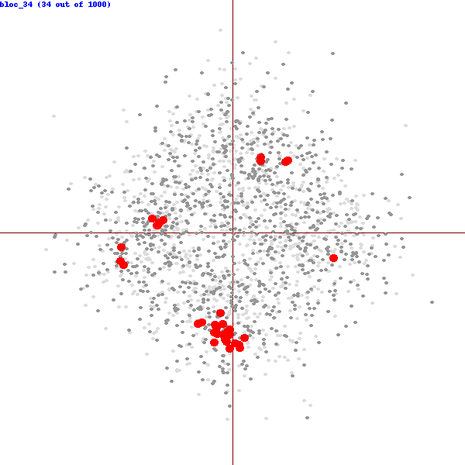
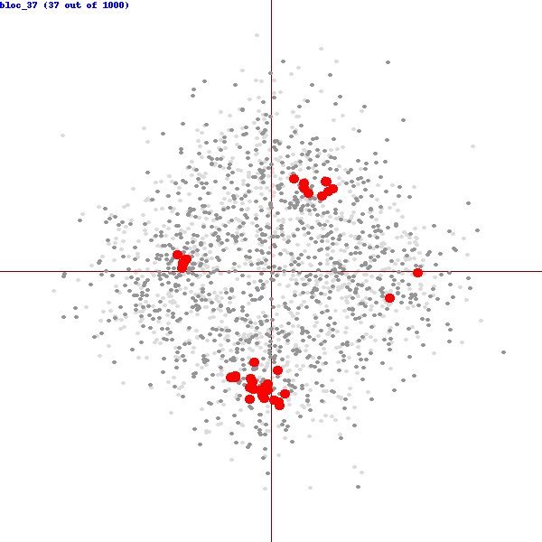
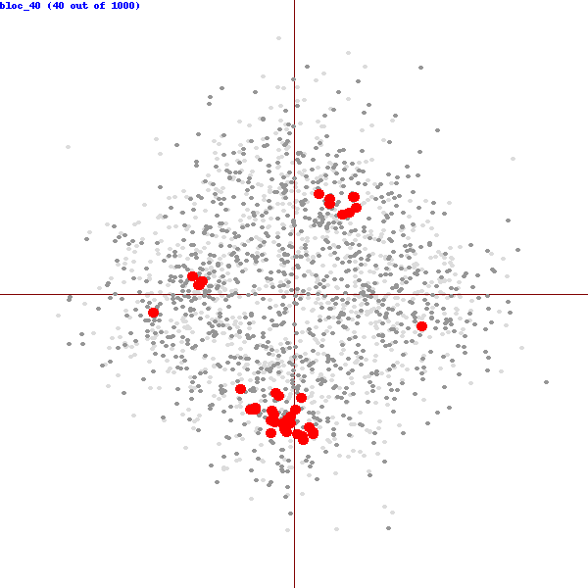
Comparison of Voting Rules
2D-Domain Experiment: candidates: light gray, voters: dark gray, committee: red
k-Borda
Bloc
k-Borda – sum up Borda scores of the candidates
Bloc – k-Approval
1 point to each of top k candidates
E. Elkind, P. Faliszewski, JR. Laslier, P. Skowron, A. Slinko, and N. Talmon: What Do Multiwinner Voting Rules Do? An Experiment Over the Two-Dimensional Euclidean Domain, AAAI 2017

Slide 20
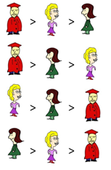
Comparison of Voting Rules
2D-Domain Experiment: candidates: light gray, voters: dark gray, committee: red
Problem with Bloc
k-Borda
Bloc
k-Borda – sum up Borda scores of the candidates
Bloc – k-Approval
1 point to each of top k candidates

Slide 21
Comparison of Voting Rules
2D-Domain Experiment: candidates: light gray, voters: dark gray, committee: red
Problem with Bloc
k-Borda
Bloc
k-Borda – sum up Borda scores of the candidates
Bloc – k-Approval
1 point to each of top k candidates

Slide 22
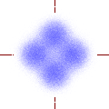
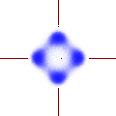
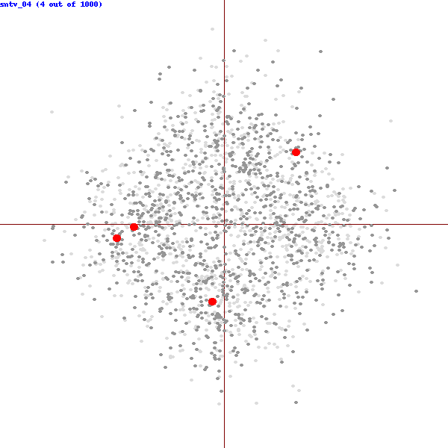
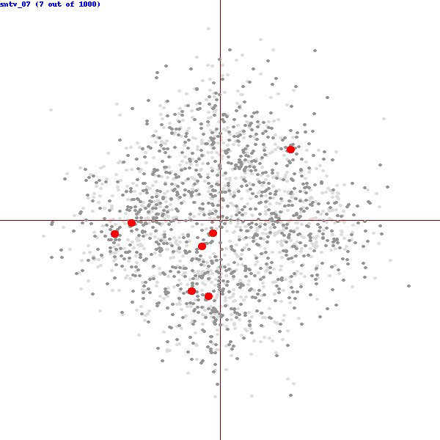
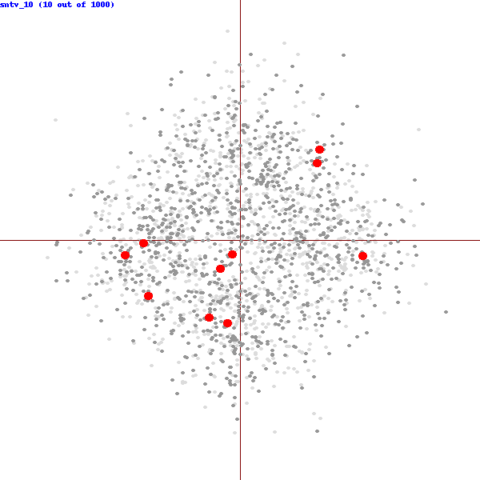
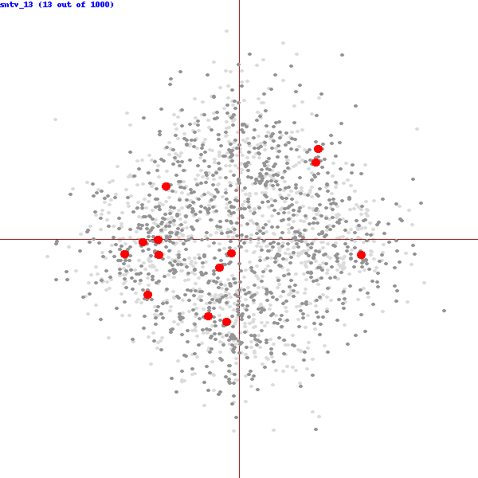
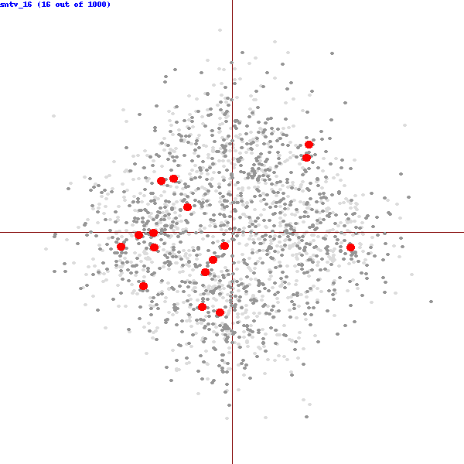
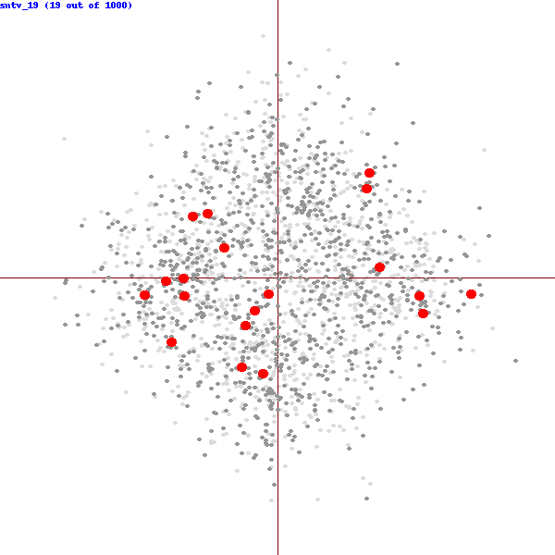
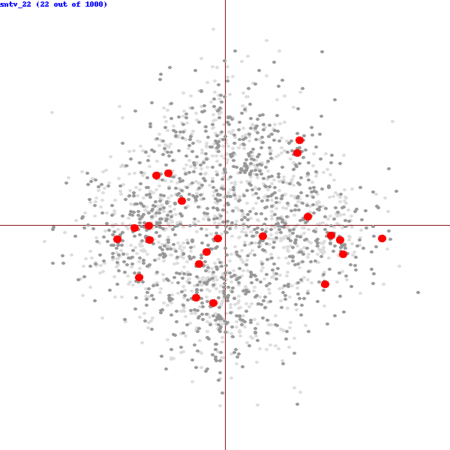
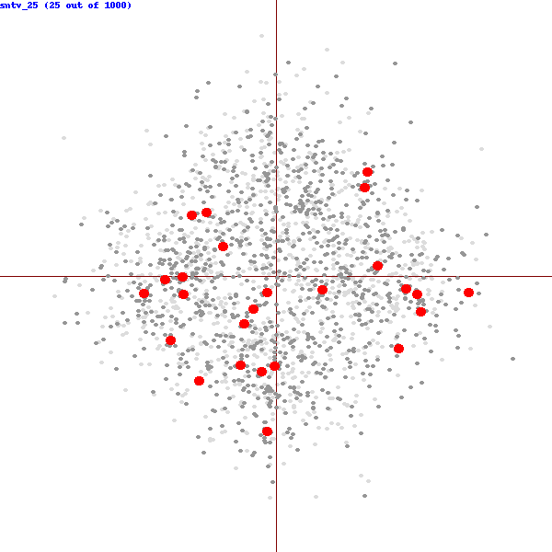
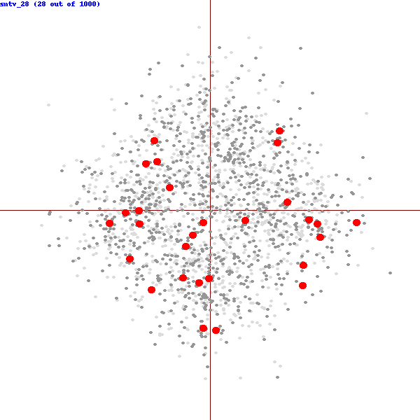
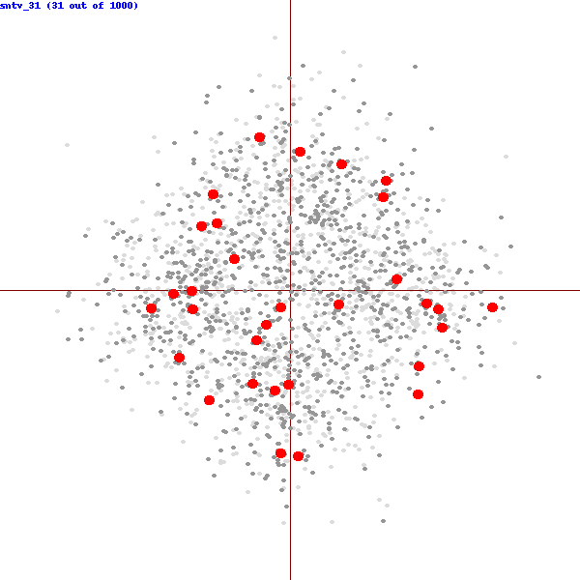
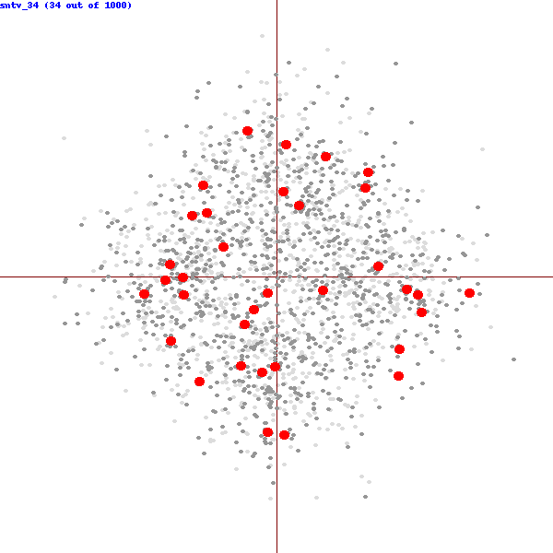
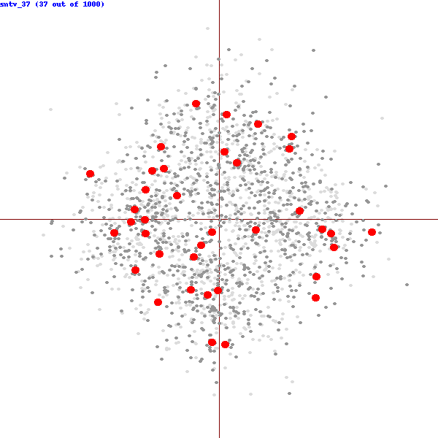
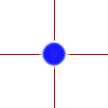
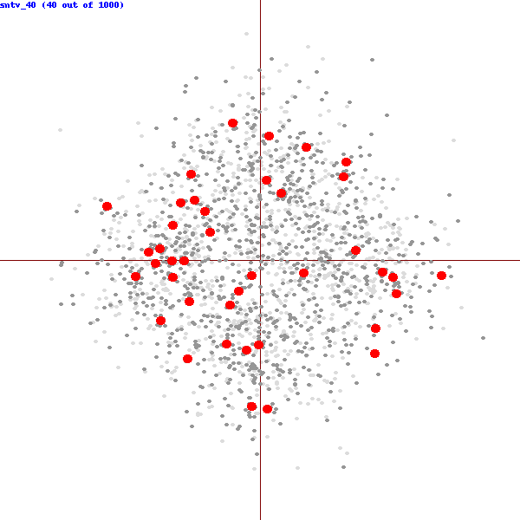
Comparison of Voting Rules
2D-Domain Experiment: candidates: light gray, voters: dark gray, committee: red
k-Borda
Bloc
1-AV (SNTV)
k-Borda – sum up Borda scores of the candidates
Bloc – k-Approval
1 point to each of top k candidates
SNTV uses Plurality scores
1 point to the top candidate

Slide 23
Comparison of Voting Rules
2D-Domain Experiment: candidates: light gray, voters: dark gray, committee: red
k-Borda
Bloc
1-AV (SNTV)
k-Borda – sum up Borda scores of the candidates
Bloc – k-Approval
1 point to each of top k candidates
SNTV uses Plurality scores
1 point to the top candidate

Slide 24
Special OWA families
1-Best OWA (1, 0, …, 0)
t-Best OWA (1, … , 1, 0, …, 0)
k-Best OWA (1, 1, …, 1)
(k-1)-Best OWA (1, …, 1, 0)
t-Median OWA (0, … 0, 1, 0, … 0)
k-Median OWA (0, …, 0, 1)
Hurwicz OWA (x, 0, …, 0, 1-x)
geometric OWA (p⁰, p¹, p², …, p^{k-1})
nonincreasing OWAs
P-time algorithm
t
NP-complete (even for Borda)
PTAS for Borda ← t/k-approximation
↓
(k-1)/k-approximation (PTAS)
t-1
(minimum)

Slide 25
(k-1)-Best: Already Hard!
A bit of a silly rule, but very similar to k-Best, yet already NP-hard
Consider how the rule works:
0 4 1 2 3
= 7
2 3 0 1 4
= 7
2 1 4 3 0
= 5
1 0 2 4 3
= 5
Take committee:
Total score = 24

Slide 26
(k-1)-Best: Already Hard!
Reduction from VertexCover
v₁
k = 3
v₂
v₅
v₄
v₃

Slide 27
(k-1)-Best: Already Hard!
Utility functions
alternatives
Reduction from VertexCover
v₁ v₂ v₃ v₄ v₅
v₁
k = 3
e₁ 1 1 0 0 0
e₂ 0 1 0 0 1
e₃ 0 1 0 1 0
e₄ 0 0 0 1 1
e₅ 0 1 1 0 0
e₆ 0 0 1 0 1
e₇ 0 0 1 1 0
e₁
v₂
e₂
v₅
g₁ 0 0 1 1 1
g₂ 1 0 1 1 0
g₃ 1 0 1 0 1
g₄ 1 1 1 0 0
g₅ 1 0 0 1 1
g₆ 1 1 0 1 0
g₇ 1 1 0 0 1
e₃
e₄
e₅
e₆
v₄
v₃
e₇

Slide 28
(k-1)-Best: Already Hard!
Utility functions
alternatives
Reduction from VertexCover
v₁ v₂ v₃ v₄ v₅
v₁
k = 3
e₁ 1 1 0 0 0
e₂ 0 1 0 0 1
e₃ 0 1 0 1 0
e₄ 0 0 0 1 1
e₅ 0 1 1 0 0
e₆ 0 0 1 0 1
e₇ 0 0 1 1 0
e₁
3 (=k)
v₂
e₂
v₅
g₁ 0 0 1 1 1
g₂ 1 0 1 1 0
g₃ 1 0 1 0 1
g₄ 1 1 1 0 0
g₅ 1 0 0 1 1
g₆ 1 1 0 1 0
g₇ 1 1 0 0 1
e₃
e₄
3
e₅
e₆
v₄
v₃
e₇
3
3
Utility = kn (n = number of edges)
3
3
3

Slide 29
(k-1)-Best: Already Hard!
Utility functions
alternatives
Reduction from VertexCover
v₁ v₂ v₃ v₄ v₅
v₁
k = 3
e₁ 1 1 0 0 0
e₂ 0 1 0 0 1
e₃ 0 1 0 1 0
e₄ 0 0 0 1 1
e₅ 0 1 1 0 0
e₆ 0 0 1 0 1
e₇ 0 0 1 1 0
e₁
3 (=k)
v₂
e₂
v₅
g₁ 0 0 1 1 1
g₂ 1 0 1 1 0
g₃ 1 0 1 0 1
g₄ 1 1 1 0 0
g₅ 1 0 0 1 1
g₆ 1 1 0 1 0
g₇ 1 1 0 0 1
e₃
e₄
3
e₅
e₆
v₄
v₃
e₇
3
3
3
3
3

Slide 30
(k-1)-Best: Already Hard!
Utility functions
alternatives
Reduction from VertexCover
v₁ v₂ v₃ v₄ v₅
v₁
k = 3
e₁ 1 1 0 0 0
e₂ 0 1 0 0 1
e₃ 0 1 0 1 0
e₄ 0 0 0 1 1
e₅ 0 1 1 0 0
e₆ 0 0 1 0 1
e₇ 0 0 1 1 0
e₁
2 (=k-1)
v₂
e₂
v₅
g₁ 0 0 1 1 1
g₂ 1 0 1 1 0
g₃ 1 0 1 0 1
g₄ 1 1 1 0 0
g₅ 1 0 0 1 1
g₆ 1 1 0 1 0
g₇ 1 1 0 0 1
e₃
e₄
3
e₅
e₆
v₄
v₃
e₇
3
3
Utility ≤ kn-1 (n = number of edges)
3
3
3

Slide 31
(k-1)-Best: Already Hard!
Utility functions
alternatives
Reduction from VertexCover
v₁ v₂ v₃ v₄ v₅
v₁
k = 3
e₁ 1 1 0 0 0
e₂ 0 1 0 0 1
e₃ 0 1 0 1 0
e₄ 0 0 0 1 1
e₅ 0 1 1 0 0
e₆ 0 0 1 0 1
e₇ 0 0 1 1 0
e₁
2 (=k-1)
v₂
e₂
v₅
g₁ 0 0 1 1 1
g₂ 1 0 1 1 0
g₃ 1 0 1 0 1
g₄ 1 1 1 0 0
g₅ 1 0 0 1 1
g₆ 1 1 0 1 0
g₇ 1 1 0 0 1
e₃
e₄
3
e₅
e₆
v₄
v₃
e₇
3
3
Stays NP-complete for Borda utilities as well, but through a much more technical proof (the same idea, though)
3
3
3

Slide 32
(k-1)-Best: Already Hard!
Utility functions
alternatives
Reduction from VertexCover
v₁ v₂ v₃ v₄ v₅
v₁
k = 3
e₁ 1 1 0 0 0
e₂ 0 1 0 0 1
e₃ 0 1 0 1 0
e₄ 0 0 0 1 1
e₅ 0 1 1 0 0
e₆ 0 0 1 0 1
e₇ 0 0 1 1 0
e₁
2 (=k-1)
v₂
e₂
v₅
g₁ 0 0 1 1 1
g₂ 1 0 1 1 0
g₃ 1 0 1 0 1
g₄ 1 1 1 0 0
g₅ 1 0 0 1 1
g₆ 1 1 0 1 0
g₇ 1 1 0 0 1
e₃
e₄
3
e₅
e₆
v₄
v₃
e₇
3
3
Hard for parameter committee size?
3
3
3

Slide 33
Special OWA families
1-Best OWA (1, 0, …, 0)
t-Best OWA (1, … , 1, 0, …, 0)
k-Best OWA (1, 1, …, 1)
(k-1)-Best OWA (1, …, 1, 0)
t-Median OWA (0, … 0, 1, 0, … 0)
k-Median OWA (0, …, 0, 1)
Hurwicz OWA (x, 0, …, 0, 1-x)
geometric OWA (p⁰, p¹, p², …, p^{k-1})
nonincreasing OWAs
NP-complete +approximation
+FPT
t
NP-complete (even for Borda)
PTAS for Borda ← t/k-approximation
↓
(k-1)/k-approximation (PTAS)
t-1
(minimum)

Slide 34
1-Best: Chamberlin—Courant Rule (CC)
Consider how the rule works:
0 4 1 2 3
= 4
2 3 0 1 4
= 4
2 1 4 3 0
= 4
1 0 2 4 3
= 3
Take committee:
Total score = 15

Slide 35
1-Best: Chamberlin—Courant Rule
Consider how the rule works:
0 4 1 2 3
= 4
2 3 0 1 4
= 4
2 1 4 3 0
= 4
1 0 2 4 3
= 3
Take committee:
Total score = 15

Slide 36
1-Best: Chamberlin—Courant Rule
4 3 2 1 0
> > > >
0 4 1 2 3
> > > >
2 3 0 1 4
2 1 4 3 0
> > > >
1 0 2 4 3
> > > >
[LB16] T. Lu and C. Boutilier: Budgeted Social Choice: From Consensus to Personalized Decision Making, IJCAI 2011

Slide 37
1-Best: GreedyCC Approximation Algorithm (1-1/e)
4 3 2 1 0
Algorithm:
for i = 1 to k do:
pick a candidate c that increases the score of the assignment most return the computed assignment
> > > >
0 4 1 2 3
> > > >
2 3 0 1 4
2 1 4 3 0
> > > >
1 0 2 4 3
> > > >
[LB16] T. Lu and C. Boutilier: Budgeted Social Choice: From Consensus to Personalized Decision Making, IJCAI 2011

Slide 38
1-Best: GreedyCC Approximation Algorithm (1-1/e)
Greedy CC
4 3 2 1 0
Algorithm:
for i = 1 to k do:
pick a candidate c that increases the score of the assignment most return the computed assignment
> > > >
> > > >
> > > >
> > > >
The apporximation ratio follows from the classic result regarding greedy optimization for submodular functions.
[LB16] T. Lu and C. Boutilier: Budgeted Social Choice: From Consensus to Personalized Decision Making, IJCAI 2011

Slide 39
Chamberlin—Courant PTAS (Borda Utilities)
x
Rank
1 2 3 m
Goal: pick K winners among m candidates, to get the highest utility
Initialize: Forget about the whole profile beyond rank x:
x = mw(K) / K (w(K) is Lambert’s W function, O(log K))
Loop: Keep picking the candidate that appears in the „available” part of the profile most frequently.
v₁
v₂
v_{n}
P. Faliszewski, P. Skowron, A. Slinko: Achieving Fully Proportional Representation: Approximability Results, Artificial Intelligence 2015

Slide 40
Chamberlin—Courant PTAS (Borda Utilities)
x
Rank
1 2 3 m
Goal: pick K winners among m candidates, to get the highest utility
Initialize: Forget about the whole profile beyond rank x:
x = mw(K) / K (w(K) is Lambert’s W function, O(log K))
Loop: Keep picking the candidate that appears in the „available” part of the profile most frequently.
v₁
v₂
v_{n}
P. Faliszewski, P. Skowron, A. Slinko: Achieving Fully Proportional Representation: Approximability Results, Artificial Intelligence 2015

Slide 41
Chamberlin—Courant PTAS (Borda Utilities)
x
Rank
1 2 3 m
Goal: pick K winners among m candidates, to get the highest utility
Initialize: Forget about the whole profile beyond rank x:
x = mw(K) / K (w(K) is Lambert’s W function, O(log K))
Loop: Keep picking the candidate that appears in the „available” part of the profile most frequently.
Guarantee: n(m-1)(1 – 2w(K)/K) utility
v₁
v₂
v_{n}
P. Faliszewski, P. Skowron, A. Slinko: Achieving Fully Proportional Representation: Approximability Results, Artificial Intelligence 2015

Slide 42
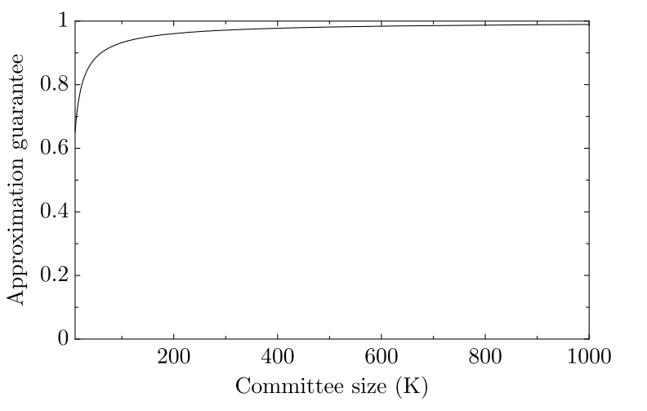
Chamberlin—Courant PTAS (Borda Utilities)

Slide 43
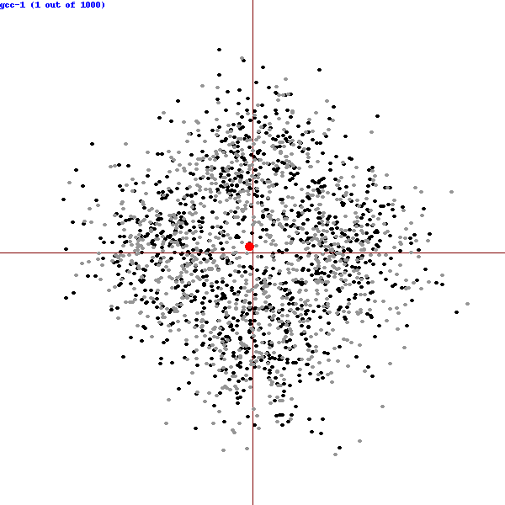
Performance in Practice
Greedy CC
Algorithm P

Slide 44
CC
Greedy 1-1/e
PTAS

Slide 45
RangingCC
x
Rank
1 2 3 m
v₁
v₂
v_{n}

Slide 46
CC
GreedyCC
Algorithm P
RangingCC

Slide 47
What About Approval Utilities?

Slide 48
Borda versus Approval
Why are Borda utilities easier to deal with than approval utilities?
(x,y)-non-finicky utilities: At least fraction x of the items get fraction y of the highest utility
Approval
Borda
Utility for item ranked at a given position
1 2 3 4 5 6 7 8 9
Item rank

Slide 49
Approval-Based Chamberlin—Courant
Set Cover
3
1
4
6
2
5

Slide 50
Approval-Based Chamberlin—Courant
Set Cover
1-Best (Approval)
v₁:
3
1
v₂:
4
6
v₃:
v₄:
2
v₅:
5
v₆:
k = number of sets we can use

Slide 51
Approval-Based Chamberlin—Courant
Set Cover
1-Best (Approval)
v₁:
3
1
v₂:
4
6
v₃:
v₄:
2
v₅:
5
v₆:
k = number of sets we can use

Slide 52
Approval-Based Chamberlin—Courant
1-Best (Approval)
For approval utilities we inherit all hardness results from SetCover/MaxCover:
NP-hardness
W[2]-hardness (k)
(1-1/e)-approx. upper bound
v₁:
v₂:
v₃:
v₄:
v₅:
v₆:
N. Betzler, A. Slinko, J. Uhlmann: On the Computation of Fully Proportional Representation, Journal of Artificial Intelligence Research 2013

Slide 53
Approval-Based Chamberlin—Courant
1-Best (Approval)
The only chance to get better results is through FPT algorithms
Parameter: m = #candidates
Trivial bruteforce approach. Try all subset of k candidates:
m^{k} ≤ m^{m}
v₁:
v₂:
v₃:
v₄:
v₅:
v₆:

Slide 54
Approval-Based Chamberlin—Courant
1-Best (Approval)
The only chance to get better results is through FPT algorithms
Parameter: n = #agents
More involved (but still simple).
Partition agents into at most k+1 groups (k ≤ n) (guess).
For all but the last group, find a commonly approved candidate.
The last group are agents wihtout good representatitve
v₁:
v₂:
v₃:
v₄:
v₅:
v₆:

Slide 55
Approval-Based Chamberlin—Courant
Parametrization by committee size?
W[2]-hardness
… but assume that each voter approves at most p candidates (where p is a constant)
Algorithm 1
Pick (2pk/(1-β)+k)^{k} candidates that are most frequently approved.
Try all size-k committees of these candidates.
Output the best one
FPT Approximation Scheme!
Finds β-approximate solution in FPT time
P. Skowron, P. Faliszewski: Chamberlin--Courant Rule with Approval Ballots: Approximating the MaxCover Problem with Bounded Frequencies in FPT Time, Journal of Artificial Intelligence Research 2017

Slide 56
Approval-Based Chamberlin—Courant
Parametrization by committee size?
W[2]-hardness
… but assume that each voter approves at most p candidates (where p is a constant)
… what if we want to minimize the number of voters without representative?
Algorithm 1
Pick (2pk/(1-β)+k)^{k} candidates that are most frequently approved.
Try all size-k committees of these candidates.
Output the best one
Algorithm 2
Search tree algorithm
Choose a voter withour representative (randomly)
Branch into ≤p subtrees, one for each candidate he/she approves of.

Slide 57
Approval-Based Chamberlin—Courant
v₂
Algorithm 1
Pick (2pk/(1-β)+k)^{k} candidates that are most frequently approved.
Try all size-k committees of these candidates.
Output the best one
v₃
Algorithm 2
Search tree algorithm
Choose a voter withour representative (randomly)
Branch into ≤p subtrees, one for each candidate he/she approves of.

Slide 58
Approval-Based Chamberlin—Courant
v₂
Algorithm 1
Pick (2pk/(1-β)+k)^{k} candidates that are most frequently approved.
Try all size-k committees of these candidates.
Output the best one
v₃
Algorithm 2
Search tree algorithm
Choose a voter withour representative (randomly)
Branch into ≤p subtrees, one for each candidate he/she approves of.

Slide 59
Approval-Based Chamberlin—Courant
v₂
Algorithm 1
Pick (2pk/(1-β)+k)^{k} candidates that are most frequently approved.
Try all size-k committees of these candidates.
Output the best one
v₁
v₃
Algorithm 2
Search tree algorithm
Choose a voter without representative (randomly)
Branch into ≤p subtrees, one for each candidate he/she approves of.

Slide 60
Approval-Based Chamberlin—Courant
v₂
Algorithm 1
Pick (2pk/(1-β)+k)^{k} candidates that are most frequently approved.
Try all size-k committees of these candidates.
Output the best one
v₁
v₃
Why does it work?
Algorithm 2
Search tree algorithm
Choose a voter without representative (randomly)
Branch into ≤p subtrees, one for each candidate he/she approves of.
Intuition: If there is a solution that gives a representative to every voter, then the algorithm will find it
For each sequence of voters (irrespective of the order) there are choices of good candidates, and the algorithm will try them

Slide 61
Approval-Based Chamberlin—Courant
v₂
Algorithm 1
Pick (2pk/(1-β)+k)^{k} candidates that are most frequently approved.
Try all size-k committees of these candidates.
Output the best one
v₁
v₃
Why does it work?
P – probability of finding β-approximate solution
C* – an optimal committee
N* – voters who have representatives under C*
U* – voters who do not have representatvies under C*
Algorithm 2
Search tree algorithm
Choose a voter without representative (randomly)
Branch into ≤p subtrees, one for each candidate he/she approves of.
X – voters without representatives at some node in the tree.
If less than (β-1)/β fraction of X belong to N*, then
more than (1/β)X belongs to U*,
so (1/β)X ≤ U*, so X ≤ βU*

Slide 62
Approval-Based Chamberlin—Courant
Generalized in: P. Skowroni:FPT approximation schemes for maximizing submodular functions, Information and Computation 2017
v₂
Algorithm 1
Pick (2pk/(1-β)+k)^{k} candidates that are most frequently approved.
Try all size-k committees of these candidates.
Output the best one
v₁
v₃
Why does it work?
P – probability of finding β-approximate solution
C* – an optimal committee
N* – voters who have representatives under C*
U* – voters who do not have representatvies under C*
Algorithm 2
Search tree algorithm
Choose a voter without representative (randomly)
Branch into ≤p subtrees, one for each candidate he/she approves of.
X – voters without representatives at some node in the tree.
If always more than (β-1)/β fraction of X belong to N*, then
P ≥ ((β-1)/β)^{k}
So (β/(β-1))^{k} trials for a high probability of success

Slide 63
Special OWA families
1-Best OWA (1, 0, …, 0)
t-Best OWA (1, … , 1, 0, …, 0)
k-Best OWA (1, 1, …, 1)
(k-1)-Best OWA (1, …, 1, 0)
t-Median OWA (0, … 0, 1, 0, … 0)
k-Median OWA (0, …, 0, 1)
Hurwicz OWA (x, 0, …, 0, 1-x)
harmonic OWA (1, 1/2, 1/3, …, 1/k)
nonincreasing OWAs
NP-complete +approximation
+FPT
t
t-1
(minimum)
NP-complete +approximation

Slide 64
Special OWA families
1-Best OWA (1, 0, …, 0)
t-Best OWA (1, … , 1, 0, …, 0)
k-Best OWA (1, 1, …, 1)
(k-1)-Best OWA (1, …, 1, 0)
t-Median OWA (0, … 0, 1, 0, … 0)
k-Median OWA (0, …, 0, 1)
Hurwicz OWA (x, 0, …, 0, 1-x)
harmonic OWA (1, 1/2, 1/3, …, 1/k)
nonincreasing OWAs
t
t-1
(minimum)
NP-complete +approximation

Slide 65
Overview for
Parametrized Complexity
Special OWA families
1-Best OWA (1, 0, …, 0)
t-Best OWA (1, … , 1, 0, …, 0)
k-Best OWA (1, 1, …, 1)
(k-1)-Best OWA (1, …, 1, 0)
t-Median OWA (0, … 0, 1, 0, … 0)
k-Median OWA (0, …, 0, 1)
Hurwicz OWA (x, 0, …, 0, 1-x)
harmonic OWA (1, 1/2, 1/3, …, 1/k)
nonincreasing OWAs
#candidates – not much left for OWA rules (a lot of left for approximation algorithms and other rules!)
t
#voters – established for basic rules (but remain open for others—active study!)
t-1
#committee size – not much hope for FPT (but try (k-1)-best)
FPT-AS for nonincreasing OWAs, but not-nonincreasing are waiting!
Go! Go! Go! Go!
(minimum)

Slide 66
E. Elkind, P. Faliszewski, P. Skowron, A. Slinko, Properties of Multiwinner Voting Rules, Social Choice and Welfare, 2017
Piotr Faliszewski, Piotr Skowron, Arkadii M. Slinko, Nimrod Talmon: Multiwinner Analogues of the Plurality Rule: Axiomatic and Algorithmic Perspectives. AAAI 2016
P. Faliszewski, P. Skowron, A. Slinko, N. Talmon, Committtee Scoring Rules: Axiomatic Classification and Hierarchy, AAAI-2016
Martin Lackner, Piotr Skowron: Consistent Approval-Based Multi-Winner Rules. arXiv 2017
P. Skowron, P. Faliszewski, A. Slinko, Axiomatic Characterization of Committee Scoring Rules, arXiv 2016
Chamberlin—Courant
OWA
k-Borda
PAV
SNTV
Bloc
Approval-Based Counting Rules
Committee Scoring Rules
Committee Elections

Slide 67
Approximation algorithms
GreedyCC
GreedyMonroe
Monroe
Chamberlin—Courant
OWA
k-Borda
PAV
SNTV
Bloc
Approval-Based Counting Rules
STV
STV
Committee Scoring Rules
V₁:
Committee Elections
V₂:
V₃:
V₄:
V₅:
STV: Candidates ranked first quota times (about n/(k+1)+1) get elected. If there are no such candidates, delete one ranked first least frequently
V₆:

Slide 68
Approximation algorithms
GreedyCC
GreedyMonroe
Monroe
Chamberlin—Courant
OWA
k-Borda
PAV
SNTV
LSE-Maximin
Bloc
Approval-Based Counting Rules
LSE-Copeland
NED
STV
Committee Scoring Rules
SEO
Condorcet-Inspired Rules
Committee Elections
S. Sekar, S. Sikdar, L. Xia, Condorcet Consistent Bundling with Social Choice, AAMAS 2017 H. Aziz, E. Elkind, P. Faliszewski, M. Lackner, P. Skowron, The Condorcet Principle for Multiwinner Elections: From Shortlisting to Proportionality, IJCAI 2017.

Slide 74
Approximation algorithms
Destructive Swap Bribery: If a rule is NP-hard to compute(*) then sometimes a single swap replaces unbounded numer of candidates in a committee
GreedyCC
GreedyMonroe
Monroe
Chamberlin—Courant
OWA
k-Borda
PAV
SNTV
A. D. Procaccia, J. S. Rosenschein, A. Zohar, Multi-Winner Elections: Complexity of Manipulation, Control and Winner-Determination, IJCAI 2007
D. Baumeister, S. Dennisen, L. Rey, Winner Determination and Manipulation in Minisum and Minimax Committee Elections. ADT 2015
R. Bredereck, P. Faliszewski, R. Niedermeier, N. Talmon: Complexity of Shift Bribery in Committee Elections. AAAI 2016
R. Bredereck, P. Faliszewski, A. Kaczmarczyk, R. Niedermeier, P. Skowron, N. Talmon: Robustness Among Multiwinner Voting Rules. SAGT 2017
P. Faliszewski, P. Skowron, N. Talmon, Bribery as a Measure of Candidate Success: Complexity Results for Approval-Based Multiwinner Rules, AAMAS 2017
LSE-Maximin
Bloc
Approval-Based Counting Rules
LSE-Copeland
NED
STV
Committee Scoring Rules
SEO
Condorcet-Inspired Rules
robustness
Success measure
Committee Elections
Shift-bribery
control
Bribery
manipulations
Changing Election Results

Slide 75
Summary
Committee elections
Many computational problems
Parameters
#candidates – easy for simple rules, but maybe more complicated for iterative rules (and result-changing problems)
#voters – partial results here and there (many many missing)
#committee size – some W[2]-hardness…. FPT-AS
Problems
Winner determination: Still work to be done (Condorcet!)
Bribery / control / manipulation ← only preliminary results
Do something with committee size!

Slide 76
Thank you!

Slide 77
SNTV
Bloc
k-Borda
CC
STV
PAV

